Slide 1


E4S: Extreme-scale Scientific Software Stack
https://e4s.io

Slide 2
Challenges
As our software gets more complex, it is getting harder to install tools and libraries correctly in an integrated and interoperable software stack.

Slide 3
ECP’s three technical areas have the necessary components to meet national goals
Performant mission and science applications @ scale
Aggressive RD&D Project
Mission apps & integrated S/W stack
Deployment to DOE HPC Facilities
Hardware tech advances
Application
Development (AD)
Software Technology (ST)
Hardware and Integration (HI)
Develop and enhance the predictive capability of applications critical to the DOE
24 applications including national security, to energy, earth systems, economic security, materials, and data
Deliver expanded and vertically integrated software stack to achieve full potential of exascale computing
70 unique software products spanning programming models and run times, math libraries, data and visualization
Integrated delivery of ECP products on targeted systems at leading DOE HPC facilities
6 US HPC vendors focused on exascale node and system design; application integration and software deployment to facilities

Slide 4
We work on products applications need now and into the future
Key themes:
Exploration/development of new algorithms/software for emerging HPC capabilities:
High-concurrency node architectures and advanced memory & storage technologies.
Enabling access and use via standard APIs.
Software categories:
The next generation of well-known and widely used HPC products (e.g., MPICH, OpenMPI, PETSc)
Some lesser used but known products that address key new requirements (e.g., Kokkos, RAJA, Spack)
New products that enable exploration of emerging HPC requirements (e.g., SICM, zfp, UnifyCR)
Example Products | Engagement
MPI – Backbone of HPC apps | Explore/develop MPICH and OpenMPI new features & standards.
OpenMP/OpenACC –On-node parallelism | Explore/develop new features and standards.
Performance Portability Libraries | Lightweight APIs for compile-time polymorphisms.
LLVM/Vendor compilers | Injecting HPC features, testing/feedback to vendors.
Perf Tools - PAPI, TAU, HPCToolkit | Explore/develop new features.
Math Libraries: BLAS, sparse solvers, etc. | Scalable algorithms and software, critical enabling technologies.
IO: HDF5, MPI-IO, ADIOS | Standard and next-gen IO, leveraging non-volatile storage.
Viz/Data Analysis | ParaView-related product development, node concurrency.

Slide 5
Software Technology Ecosystem
Levels of Integration Product Source and Delivery
ECP ST Individual Products
ST Products
Source: ECP L4 teams; Non-ECP Developers; Standards Groups
Delivery: Apps directly; spack; vendor stack; facility stack
SDKs
Source: ECP SDK teams; Non-ECP Products (policy compliant, spackified)
E4S
Source: ECP E4S team; Non-ECP Products (all dependencies)
Delivery: spack install e4s; containers; CI Testing
Delivery: Apps directly; spack install sdk; future: vendor/facility
Standard workflow
Existed before ECP
Group similar products
Make interoperable
Assure policy compliant
Include external products
Build all SDKs
Build complete stack
Containerize binaries
ECP ST Open Product Integration Architecture

Slide 6
Extreme-scale Scientific Software Stack (E4S)
E4S: A Spack-based distribution of ECP ST and related and dependent software tested for interoperability and portability to multiple architectures
Provides distinction between SDK usability / general quality / community and deployment / testing goals
Will leverage and enhance SDK interoperability thrust
Oct 2018: E4S 0.1 - 24 full, 24 partial release products
Jan 2019: E4S 0.2 - 37 full, 10 partial release products
Nov 2019: E4S 1.0 - 50 full, 5 partial release products
Jan 2020: E4S 1.1 – ppc64le and x86_64 release with 50 full (x86_64), 46 full (ppc64le) release products.
https://e4s.io

Slide 7
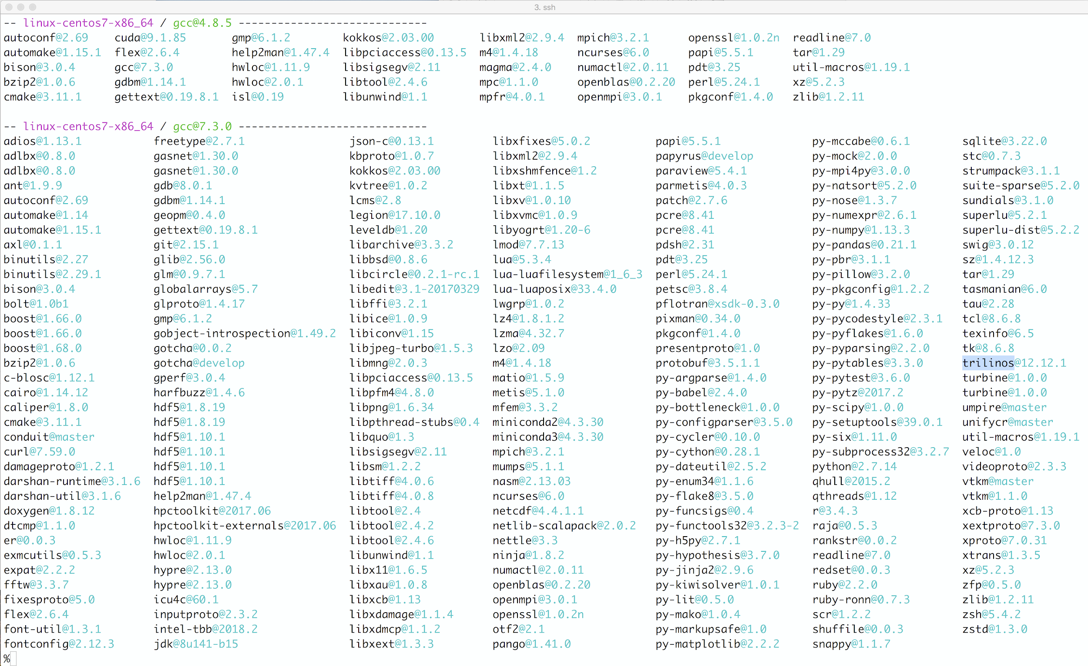
Extreme-scale Scientific Software Stack (E4S) https://e4s.io
E4S is a community effort to provide open source software packages for developing, deploying, and running scientific applications on HPC platforms.
Delivering a modular, interoperable, and deployable software stack based on Spack.
E4S provides both source builds and containers of a broad collection of HPC software packages.
Enable uniform APIs where possible
E4S exists to accelerate the development, deployment and use of HPC software, lowering the barriers for HPC users.
E4S provides containers and turn-key, from-source builds of 50+ popular HPC software packages:
MPI: MPICH and OpenMPI
Development tools: TAU, HPCToolkit, and PAPI
Math libraries: PETSc and Trilinos
Data and Viz tools: Adios, HDF5, and Paraview

Slide 8
Spack enables Software distribution for HPC
Spack automates the build and installation of scientific software
Packages are templated, so that users can easily tune for the host environment
Ease of use of mainstream tools, with flexibility needed for HPC tuning
Major victories:
ARES porting time on a new platform was reduced from 2 weeks to 3 hours
Deployment time for 1,300-package stack on Summit supercomputer reduced from 2 weeks to a 12-hour overnight build
Used by teams across ECP to accelerate development
No installation required: clone and go
$ git clone https://github.com/spack/spack
$ spack install hdf5
Simple syntax enables complex installs
$ spack install hdf5@1.10.5
$ spack install hdf5@1.10.5 %clang@6.0
$ spack install hdf5@1.10.5 +threadssafe
$ spack install hdf5@1.10.5 cppflags="-O3 –g3"
$ spack install hdf5@1.10.5 target=haswell
$ spack install hdf5@1.10.5 +mpi ^mpich@3.2
github.com/spack/spack

Slide 9
ECP SW Technology Software Architecture – SDKs

Slide 10

Software Development Kits (SDKs): Key delivery vehicle for ECP A collection of related software products (packages) where coordination across package teams improves usability and practices, and foster community growth among teams that develop similar and complementary capabilities
Domain scope Collection makes functional sense
Interaction model How packages interact; compatible, complementary, interoperable
Community policies Value statements; serve as criteria for membership
Meta-infrastructure Invokes build of all packages (Spack), shared test suites
Coordinated plans Inter-package planning. Augments autonomous package planning
Community outreach Coordinated, combined tutorials, documentation, best practices
ECP ST SDKs: Grouping similar products for collaboration & usability
Programming Models & Runtimes Core
Tools & Technologies
Compilers & Support
Math Libraries (xSDK)
Viz Analysis and Reduction
Data mgmt., I/O Services & Checkpoint/ Restart
“Unity in essentials, otherwise diversity”

Slide 11

xSDK community policies
https://xsdk.info/policies
xSDK compatible package: Must satisfy mandatory xSDK policies:
M1. Support xSDK community GNU Autoconf or CMake options.
M2. Provide a comprehensive test suite.
M3. Employ user-provided MPI communicator.
M4. Give best effort at portability to key architectures.
M5. Provide a documented, reliable way to contact the development team.
M6. Respect system resources and settings made by other previously called packages.
M7. Come with an open source license.
M8. Provide a runtime API to return the current version number of the software.
M9. Use a limited and well-defined symbol, macro, library, and include file name space.
M10. Provide an accessible repository (not necessarily publicly available).
M11. Have no hardwired print or IO statements.
M12. Allow installing, building, and linking against an outside copy of external software.
M13. Install headers and libraries under <prefix>/include/ and <prefix>/lib/.
M14. Be buildable using 64 bit pointers. 32 bit is optional.
M15. All xSDK compatibility changes should be sustainable.
M16. The package must support production-quality installation compatible with the xSDK install tool and xSDK metapackage.
Also recommended policies, which currently are encouraged but not required:
R1. Have a public repository.
R2. Possible to run test suite under valgrind in order to test for memory corruption issues.
R3. Adopt and document consistent system for error conditions/exceptions.
R4. Free all system resources it has acquired as soon as they are no longer needed.
R5. Provide a mechanism to export ordered list of library dependencies.
R6. Provide versions of dependencies.
xSDK member package: Must be an xSDK-compatible package, and it uses or can be used by another package in the xSDK, and the connecting interface is regularly tested for regressions.
We welcome feedback. What policies make sense for your software?

Slide 12
xSDK version 0.5: November 2019 (21 math libs, 2 domain-specific packages)
AMReX
ButterflyPACK
DTK
deal.ii
Ginkgo
hypre
libEnsemble
MAGMA
MFEM
Omega_h
PETSc/TAO
PHIST
PLASMA
preCICE
PUMI
SLEPc
STRUMPACK
SUNDIALS
SuperLU
Tasmanian
Trilinos
Pflotran
Alquimia
Notes:
Growth:
5 in release 0.1.
7 in 0.2
9 in 0.3
19 in 0.4
23 in 0.5
You do not need to build all packages.
We build and test all packages.
Any subset is guaranteed to build if using the same build parameters, platforms.
Similar builds should work or require less effort for success.

Slide 13
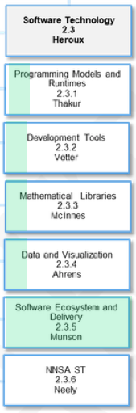
There are 5 L4 projects to define and/or enhance SDKs
WBS Areas
Each L3 area has an L4 project devoted to SDK definition and coordination across the portfolio
Software ecosystem L4 project focuses on packaging
Spack
Containers
Strong coordination with HI Software Deployment projects
Drives milestone-based planning

Slide 14
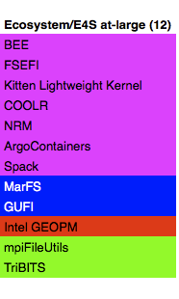
ECP ST SDKs will span all technology areas
Motivation: Properly chosen cross-team interactions will build relationships that support interoperability, usability, sustainability, quality, and productivity within ECP ST.
Action Plan: Identify product groupings where coordination across development teams will improve usability and practices, and foster community growth among teams that develop similar and complementary capabilities.
PMR Core (17)
Compilers and Support (7)
Tools and Technology (11)
xSDK (16)
Visualization Analysis and Reduction (9)
Ecosystem/E4S at-large (12)
Data mgmt, I/O Services, Checkpoint restart (12)
QUO
openarc
TAU
hypre
ParaView
SCR
mpiFileUtils
Papyrus
Kitsune
HPCToolkit
FleSCI
Catalyst
FAODEL
TriBITS
SICM
LLVM
Dyninst Binary Tools
MFEM
VTK-m
ROMIO
MarFS
Legion
CHiLL autotuning comp
Gotcha
Kokkoskernels
SZ
Mercury (Mochi suite)
GUFI
Kokkos (support)
LLVM openMP comp
Caliper
Trilinos
zfp
HDF5
Intel GEOPM
RAJA
OpenMP V & V
PAPI
SUNDIALS
VisIt
Parallel netCDF
BEE
CHAI
Flang/LLVM Fortran comp
Program Database Toolkit
PETSc/TAO
ASCENT
ADIOS
FSEFI
PaRSEC*
Search (random forests)
libEnsemble
Cinema
Darshan
Kitten Lightweight Kernel
DARMA
Siboka
STRUMPACK
ROVER
UnifyCR
COOLR
GASNet-EX
C2C
SuperLU
VeloC
NRM
Qthreads
Sonar
ForTrilinos
IOSS
ArgoContainers
BOLT
SLATE
HXHIM
Spack
UPC++
MAGMA
MPICH
DTK
Open MPI
Tasmanian
PMR
Umpire
TuckerMPI
Tools
Legend
Math Libraries
AML
Data and Vis
Ecosystems and delivery

Slide 15
ECP is working towards a periodic, hierarchical release process
In ECP, teams increasingly need to ensure that their libraries and components work together
Historically, HPC codes used very few dependencies
Now, groups related SW products work together on small releases of “Software Development Kits” - SDKs
SDKs will be rolled into a larger, periodic release – E4S.
Deployment at Facilities builds on SDKs and E4S
Integrate
Build
E4S: ECP-wide software release
Deploy
Develop
Deploy
Develop
Deploy
Develop
Test
https://e4s.io
Deploy
Math Libraries
Data and Visualization
Programming
Models
…
Test
Package
Test
Package
Test
Package
Build
Build
Build
Notes:
quick run through - what ECP ST is working on

Slide 16
E4S Components
E4S is a curated release of ECP ST products based on Spack [http://spack.io].
E4S Spack cache to support bare-metal installs at facilities and custom container builds:
x86_64, ppc64le, and aarch64
Container images on DockerHub and E4S website of pre-built binaries of ECP ST products.
Base images and full featured containers (GPU support).
GitHub recipes for creating custom images from base images.
e4s-cl for container launch and for replacing MPI in application with system MPI libraries.
Validation test suite on GitHub provides automated build and run tests.
Automates build process via GitLab Continuous Integration to ensure packages can be built.
E4S Doc Portal aggregates and summarizes documentation and metadata by raking product repos.
E4S VirtualBox image with support for Docker, Shifter, Singularity, and Charliecloud runtimes.
AWS image to deploy E4S on EC2.
https://e4s.io
Notes:
quick run through - what ECP ST is working on

Slide 17
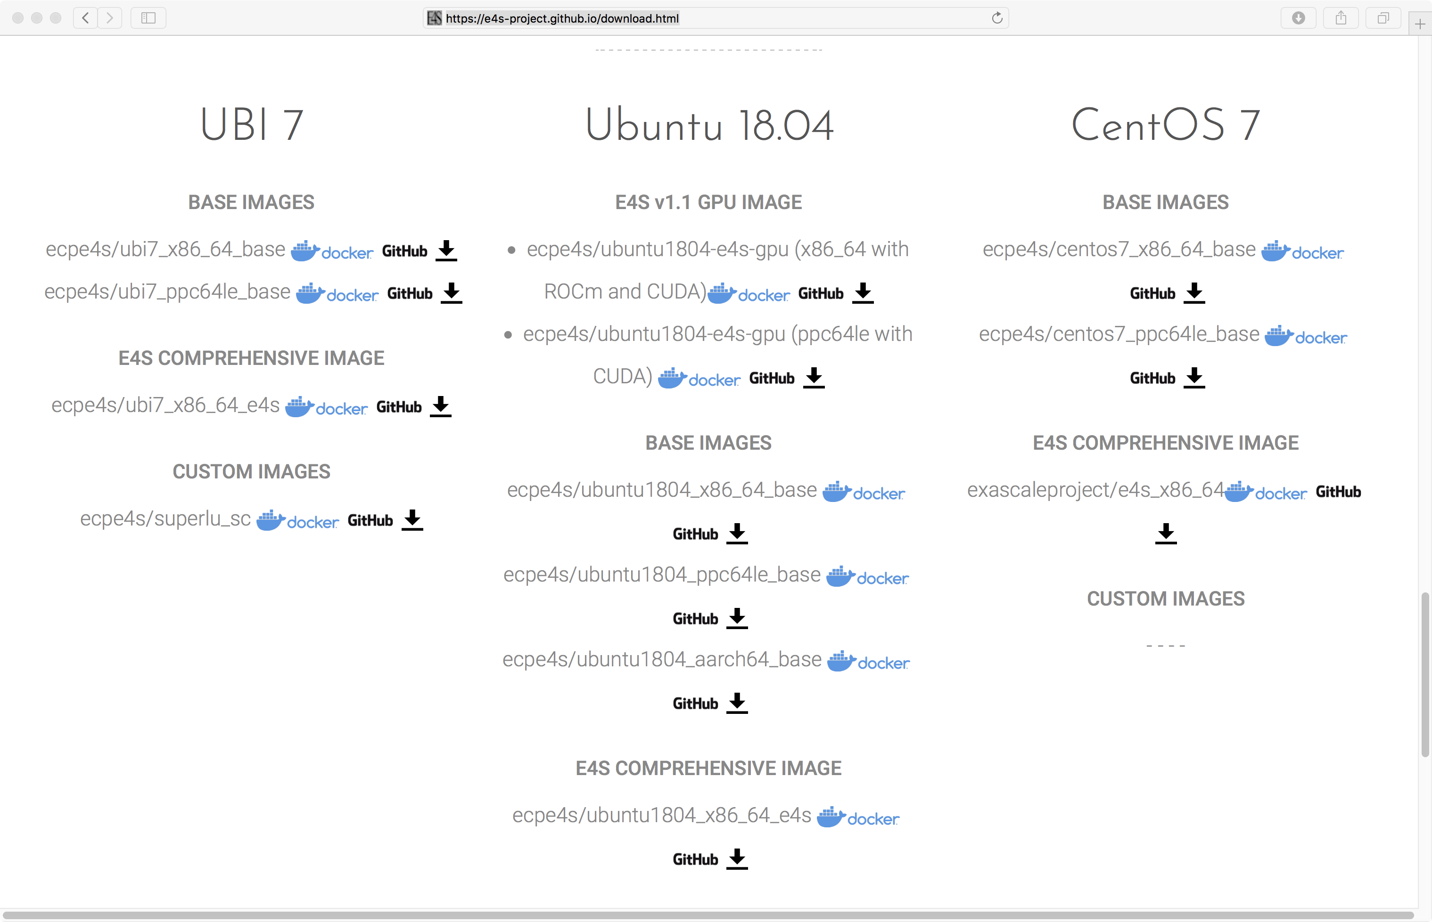
Download E4S v1.1 GPU image
https://e4s.io
Notes:
quick run through - what ECP ST is working on

Slide 18
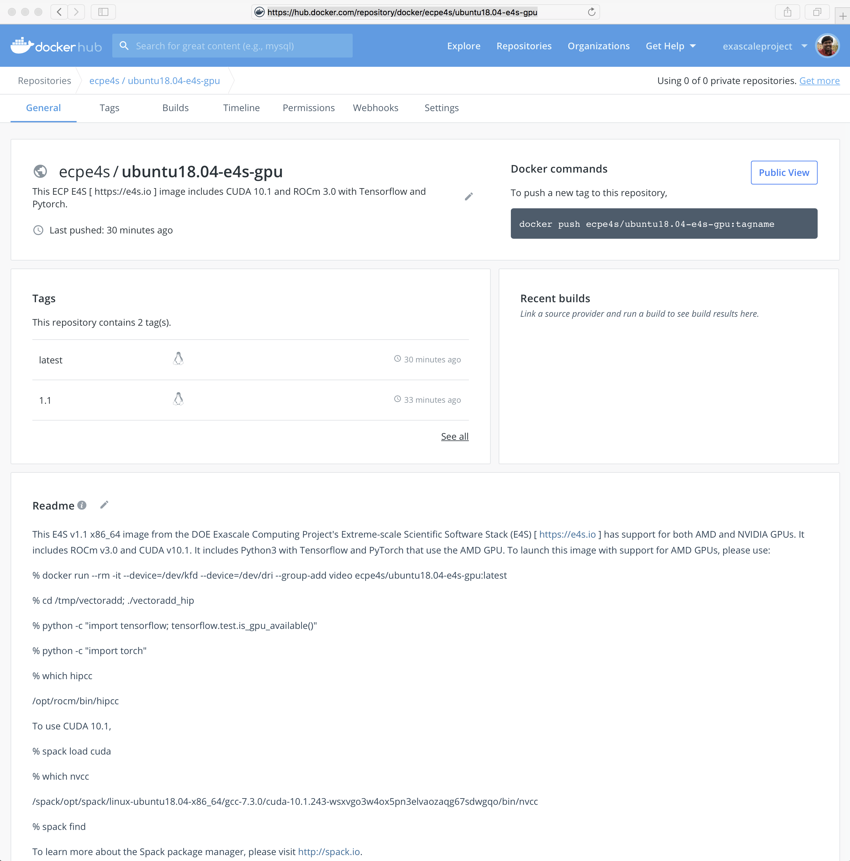
E4S v1.1 Release Available at DockerHub
50 ECP ST Products
Support for GPUs
AMD (ROCm 3.0)
NVIDIA (CUDA 10.1)
% docker pull ecpe4s/ubuntu18.04-e4s-gpu
Notes:
quick run through - what ECP ST is working on

Slide 19
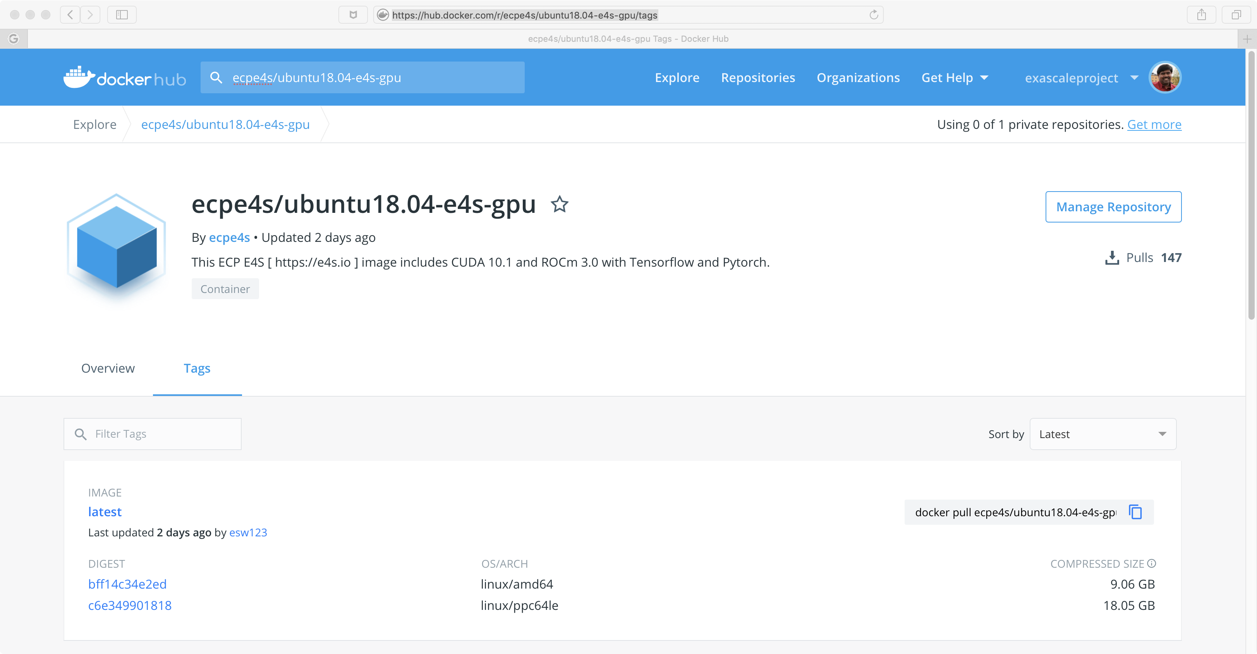
E4S v1.1 Release at DockerHub: GPU Support
40+ ECP ST Products
Support for GPUs
NVIDIA (CUDA 10.1.243)
ppc64le and x86_64
% docker pull ecpe4s/ubuntu18.04-e4s-gpu
Notes:
quick run through - what ECP ST is working on

Slide 20
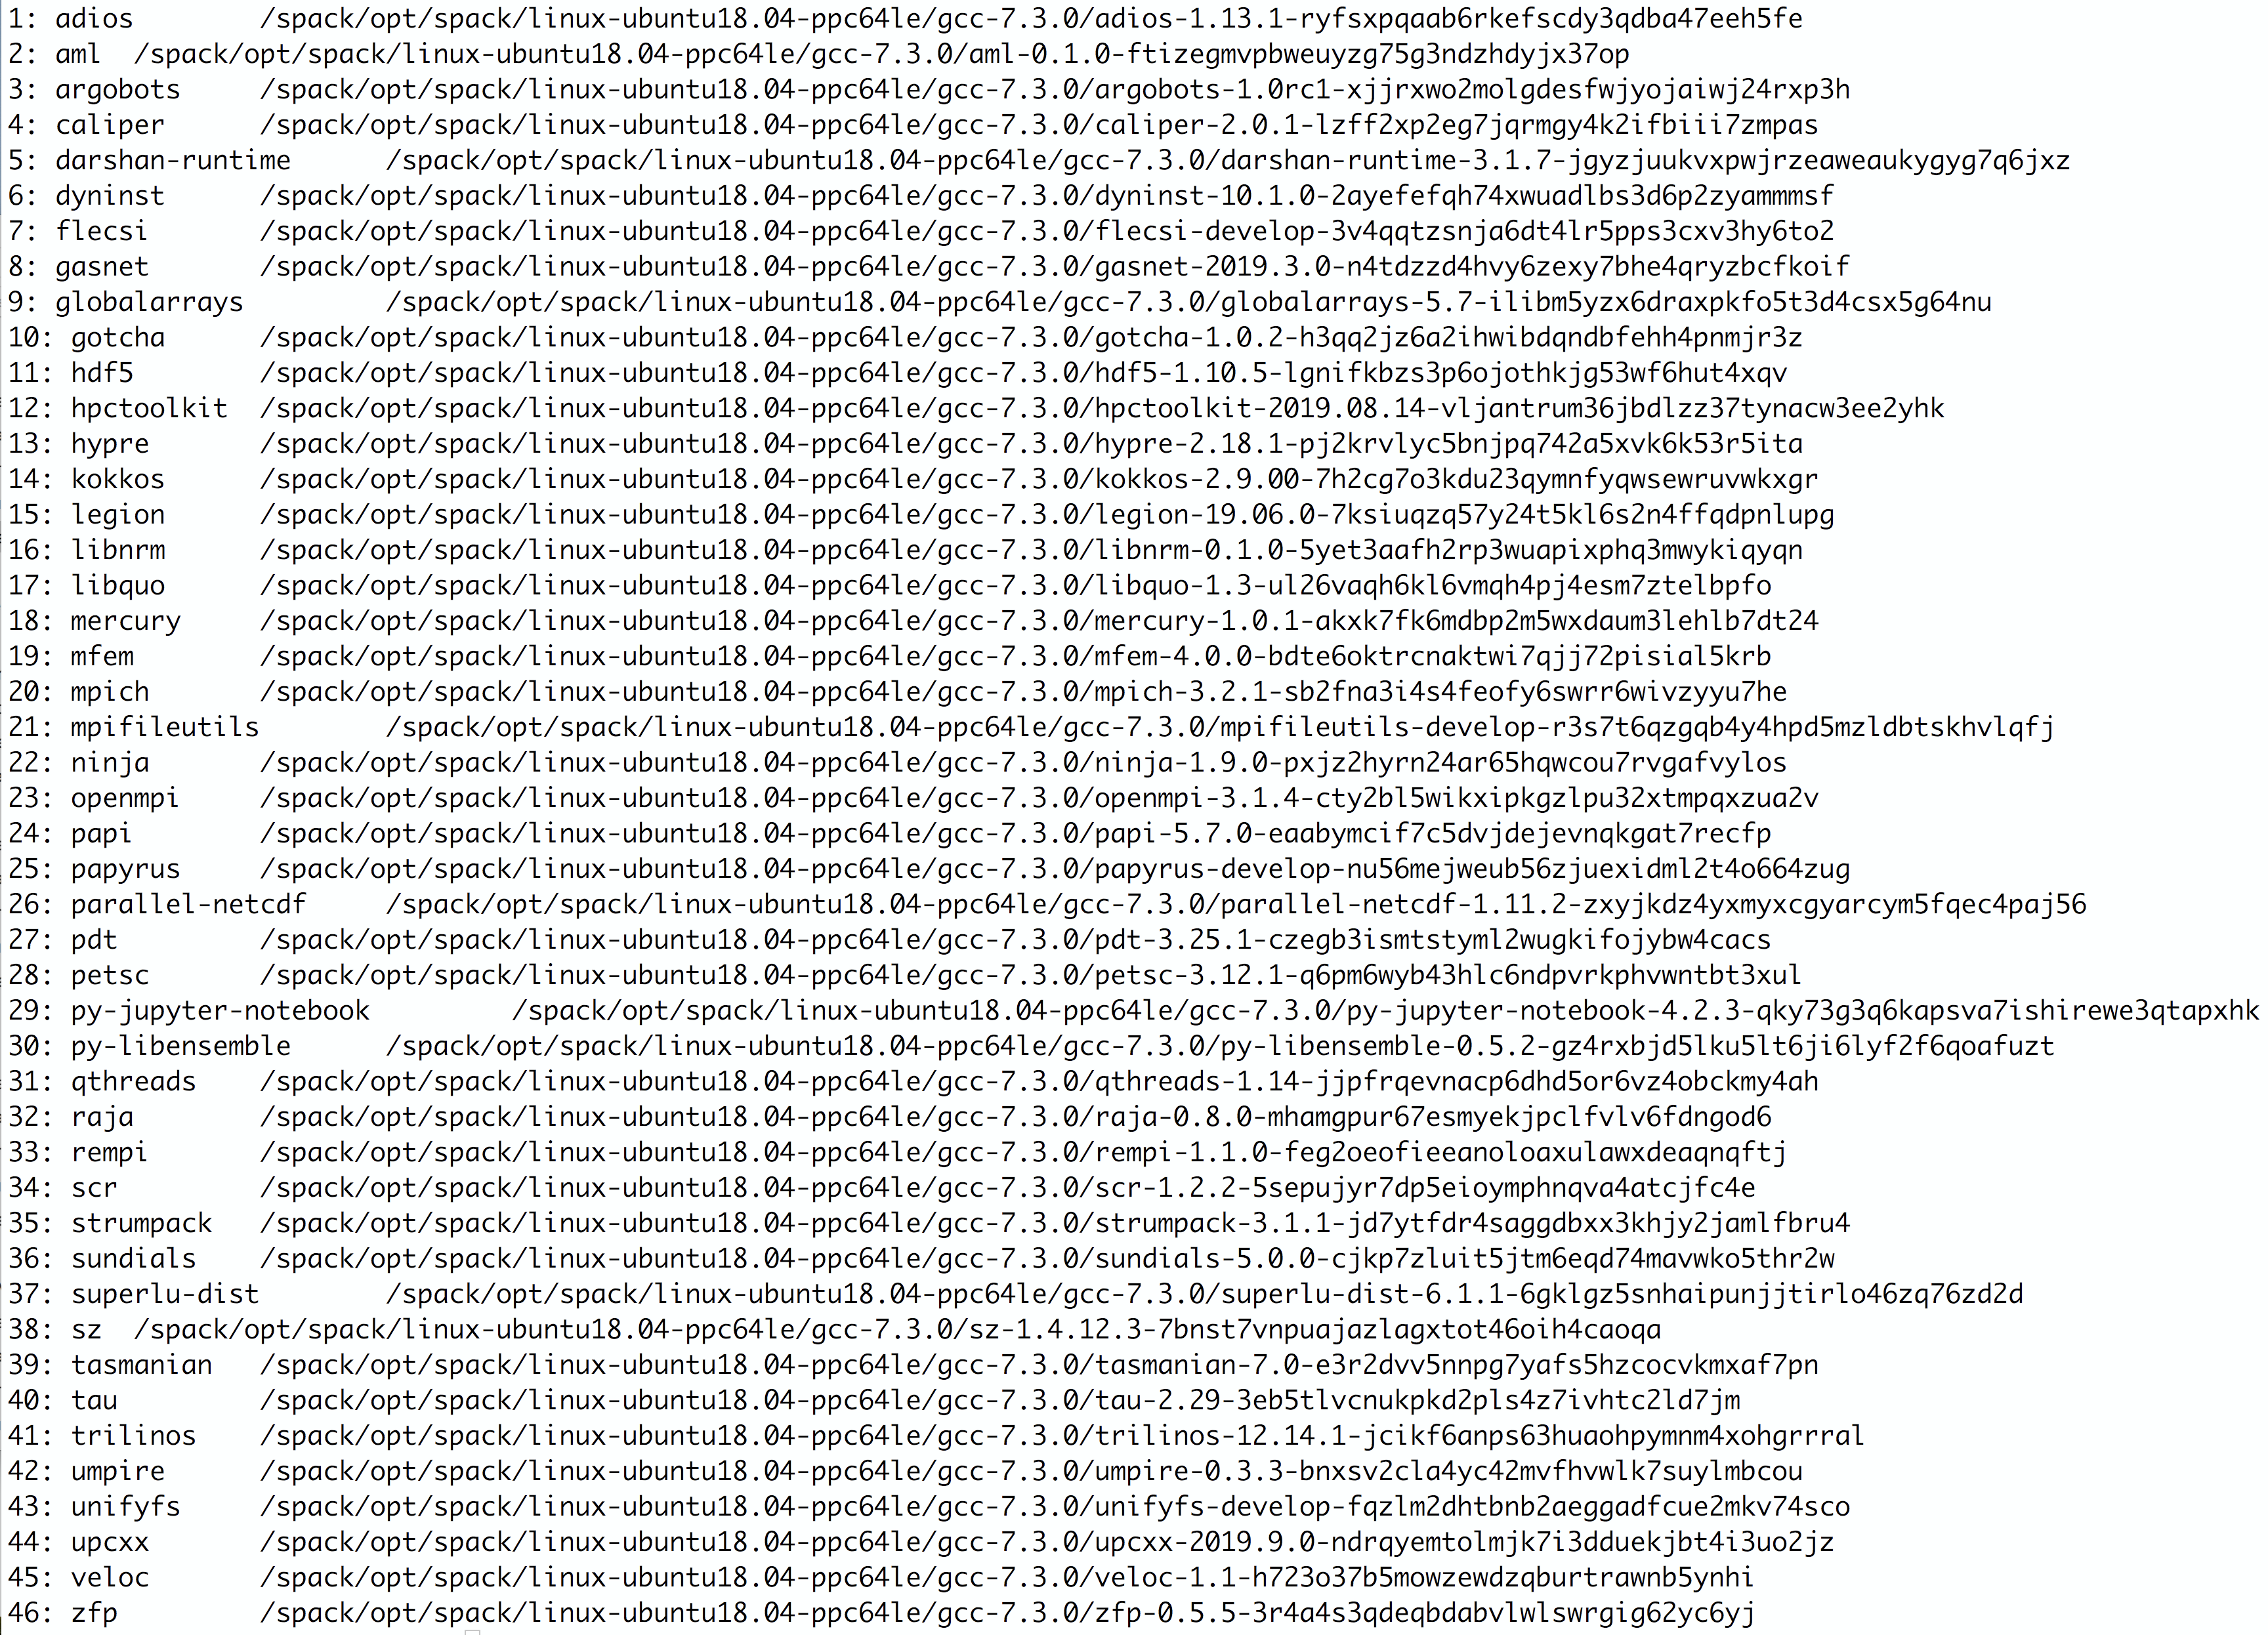
E4S v1.1 GPU Release for ppc64le
46 ECP ST products
Ubuntu v18.04 ppc64le
AI/ML package support
TensorFlow
PyTorch
Support for GPUs
NVIDIA CUDA 10.1
Notes:
quick run through - what ECP ST is working on

Slide 21
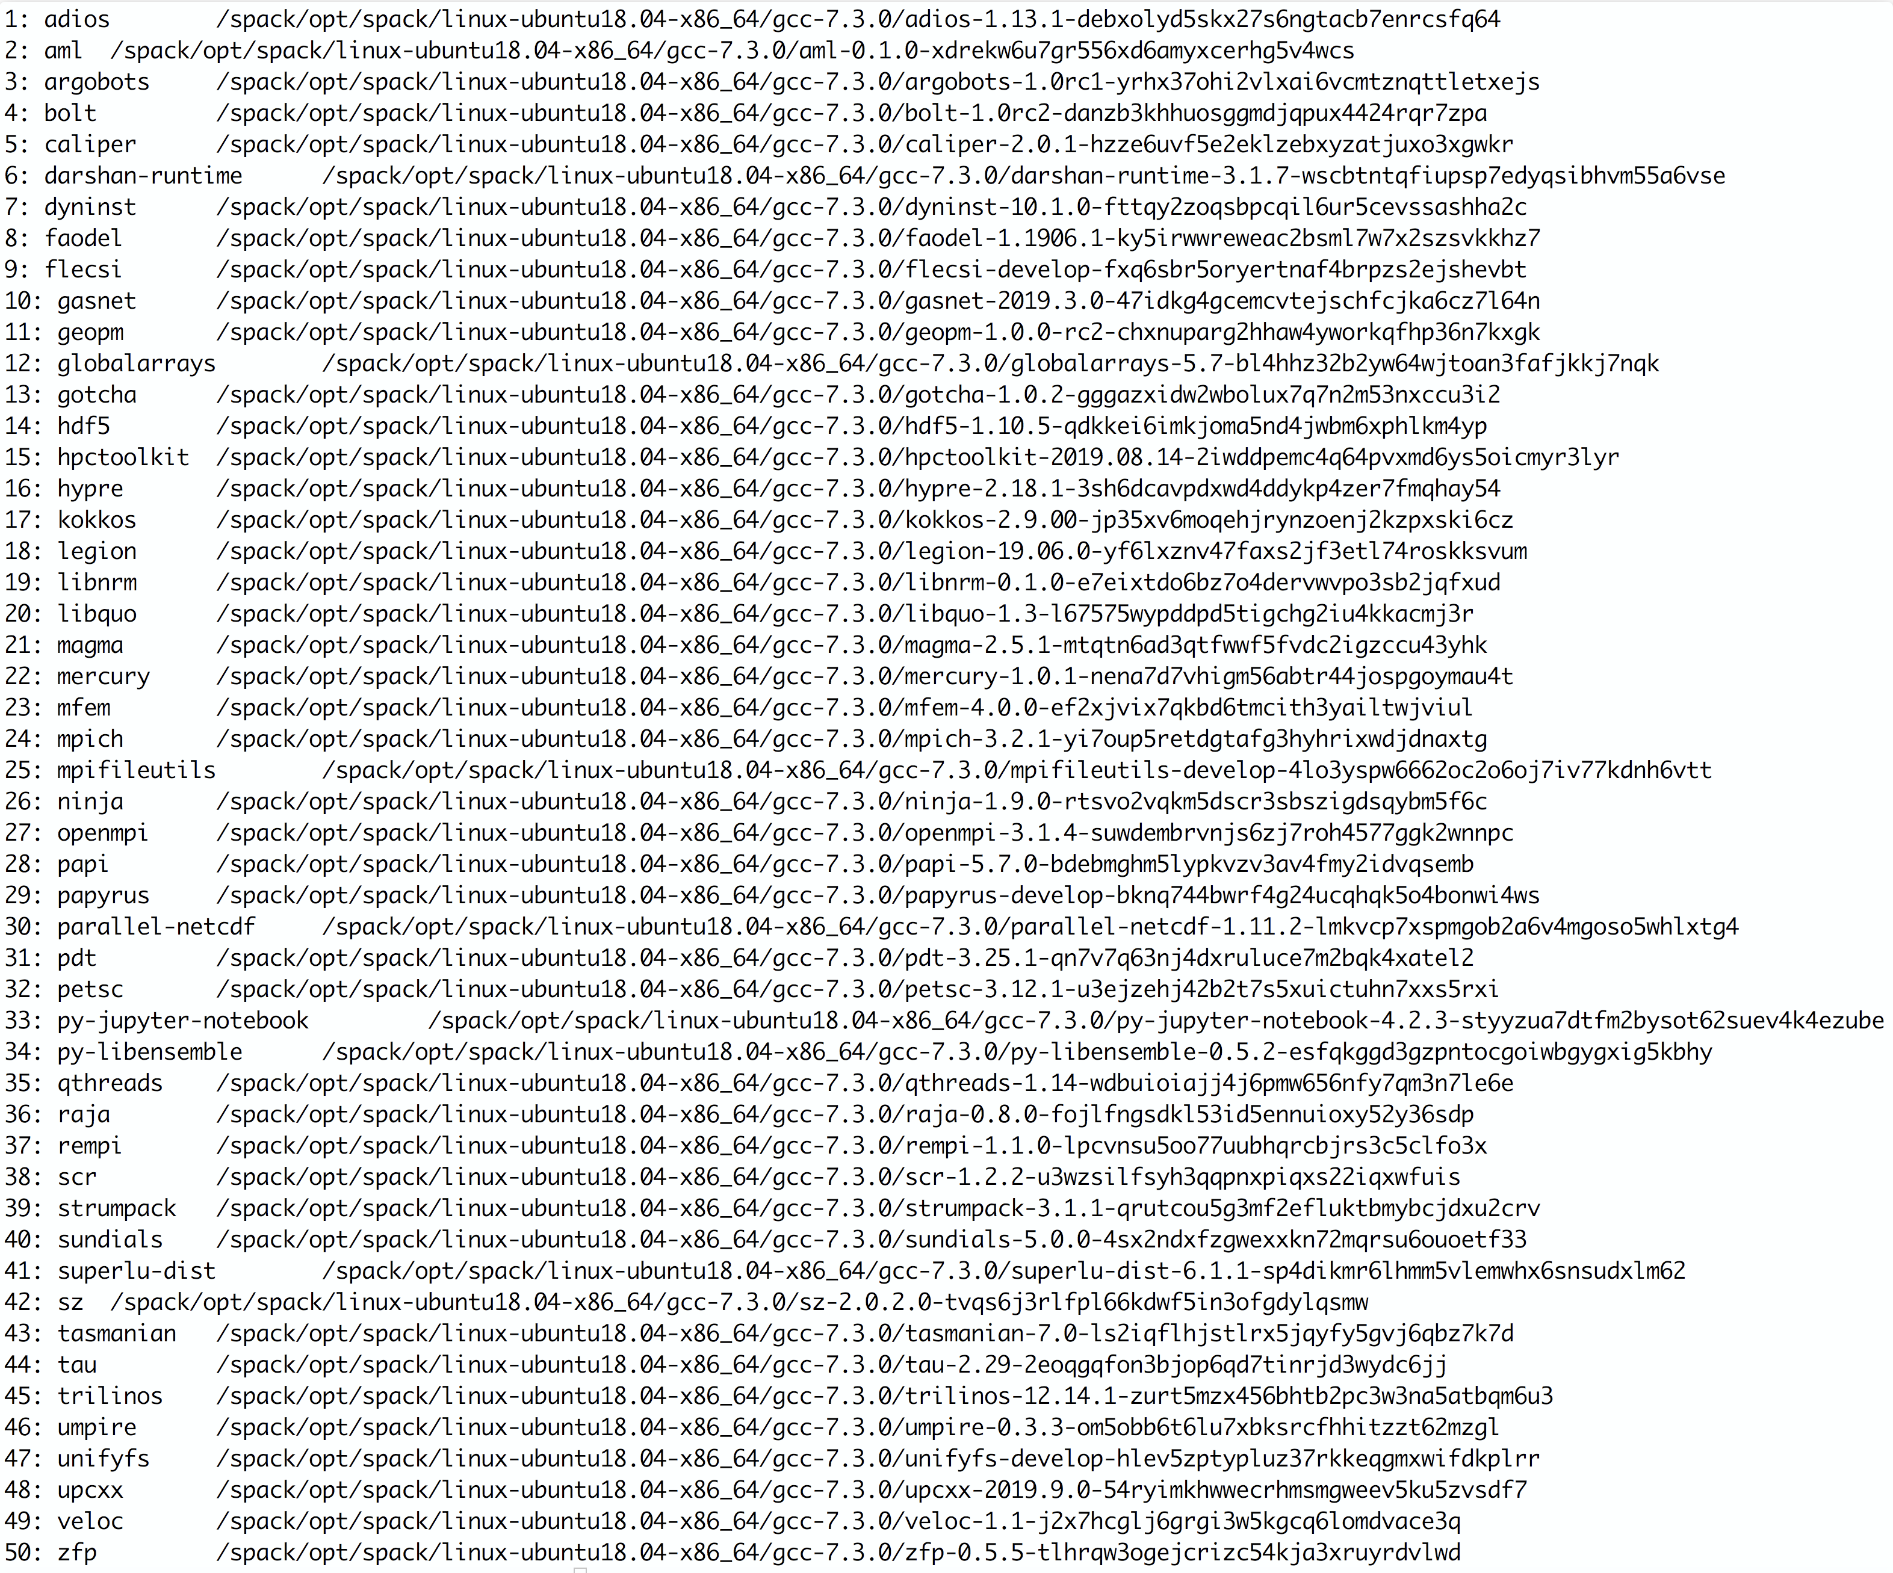
E4S v1.1 GPU Release for x86_64
50 ECP ST products
Ubuntu v18.04 x86_64
4.1 GB compressed image
AI/ML package support
TensorFlow
PyTorch
Support for GPUs
AMD ROCm 3.1
NVIDIA CUDA 10.1.248
Notes:
quick run through - what ECP ST is working on

Slide 22
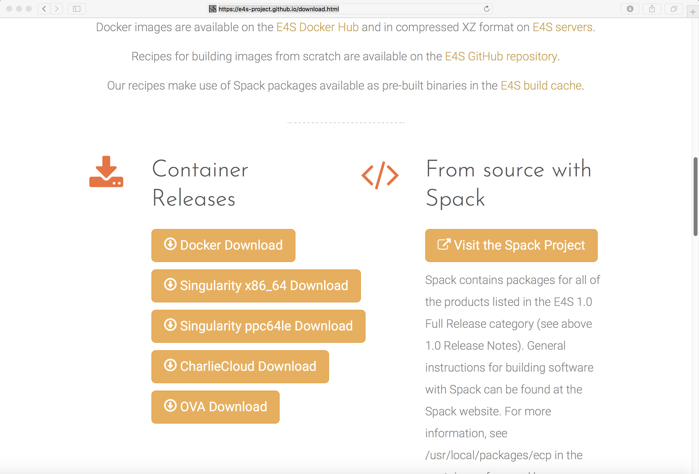

E4S Support for Singularity Container Runtime [Sylabs.io]
wget http://oaciss.uoregon.edu/e4s/images/e4s_ubuntu1804_gpu_ppc64le_1.1.simg
singularity exec --nv e4s_ubuntu1804_gpu_ppc64le_1.1.simg /bin/bash --rcfile /etc/bashrc
spack find

Slide 23
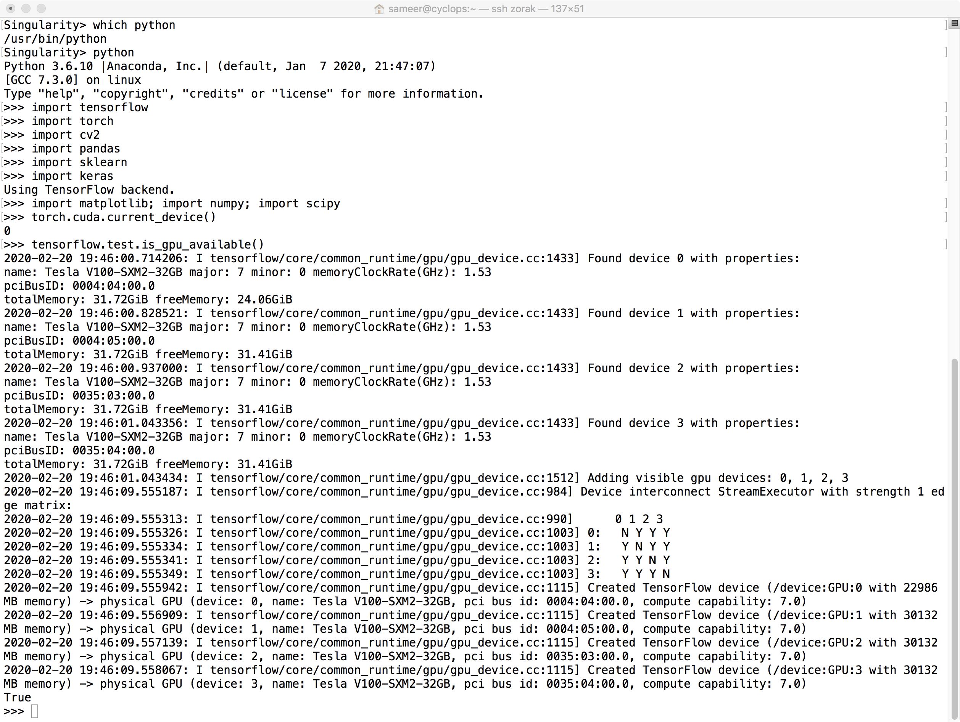
E4S v1.1 GPU Support for ppc64le
% docker pull ecpe4s/ubuntu18.04-e4s-gpu
Notes:
quick run through - what ECP ST is working on

Slide 24
E4S Spack Build Cache and Container Build Pipeline

Slide 25
Reproducible, Customizable Container Builds & Spack Mirrors
E4S provides base images and recipes for building Docker containers based on SDKs
Git: https://github.com/UO-OACISS/e4s
E4S provides build caches for Spack for native bare-metal as well as container builds based installation of ST products
Build caches: https://oaciss.uoregon.edu/e4s/inventory.html
The build cache model can be extended to target platforms, and can be managed by facilities staff when appropriate.

Slide 26
E4S Spack Environment - Current Examples
Building on AWS Cloud as part of Spack PR and Release Testing
CI Dashboard available @ https://cdash.spack.io
Building at University of Oregon
ppc64le and x86/64 systems with mpich
Building at OLCF Ascent
Working on NERSC Cori currently
See examples of how the environment is tailored for existing sites:
https://github.com/UO-OACISS/e4s/tree/master/e4s-facility-environments
Binaries available in the E4S Build Cache
https://oaciss.uoregon.edu/e4s/inventory.html
Improved inventory page currently under development

Slide 27
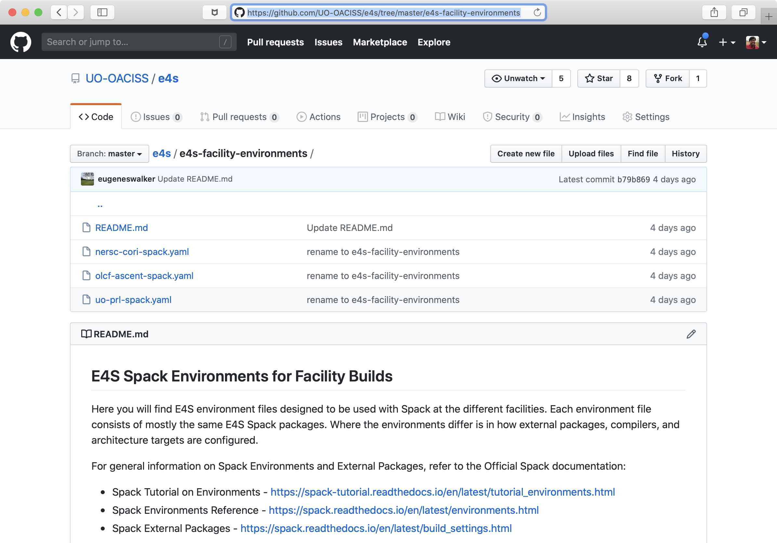
E4S Tailored to DOE Facility Environments
https://github.com/UO-OACISS/e4s/tree/master/e4s-facility-environments

Slide 28
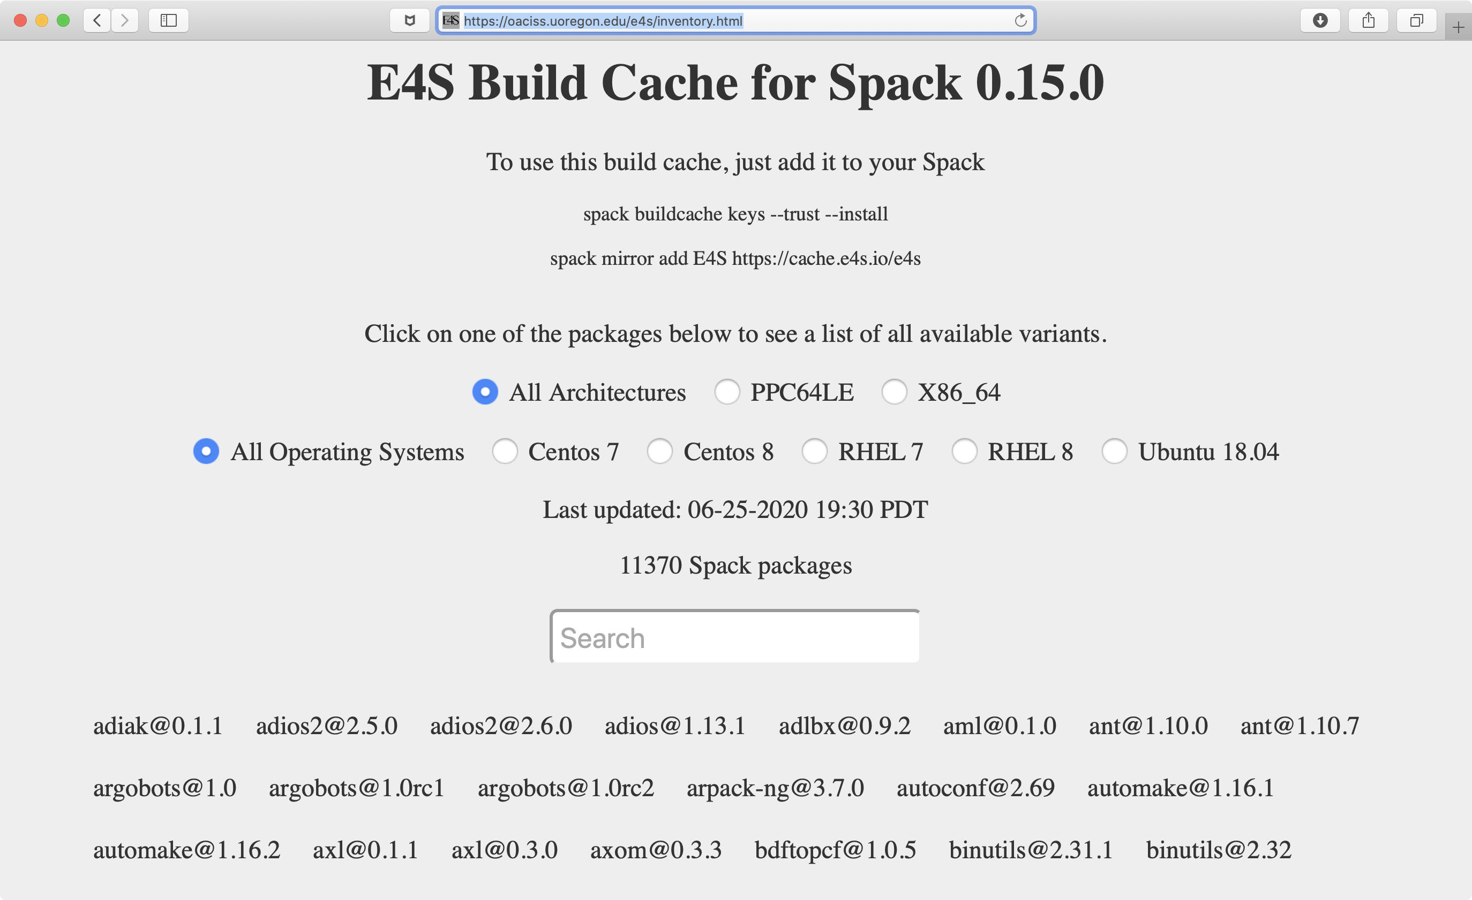
E4S: Spack Build Cache at U. Oregon
10,000+ binaries
S3 mirror
No need to build
from source code!
https://oaciss.uoregon.edu/e4s/inventory.html
Notes:
quick run through - what ECP ST is working on

Slide 29
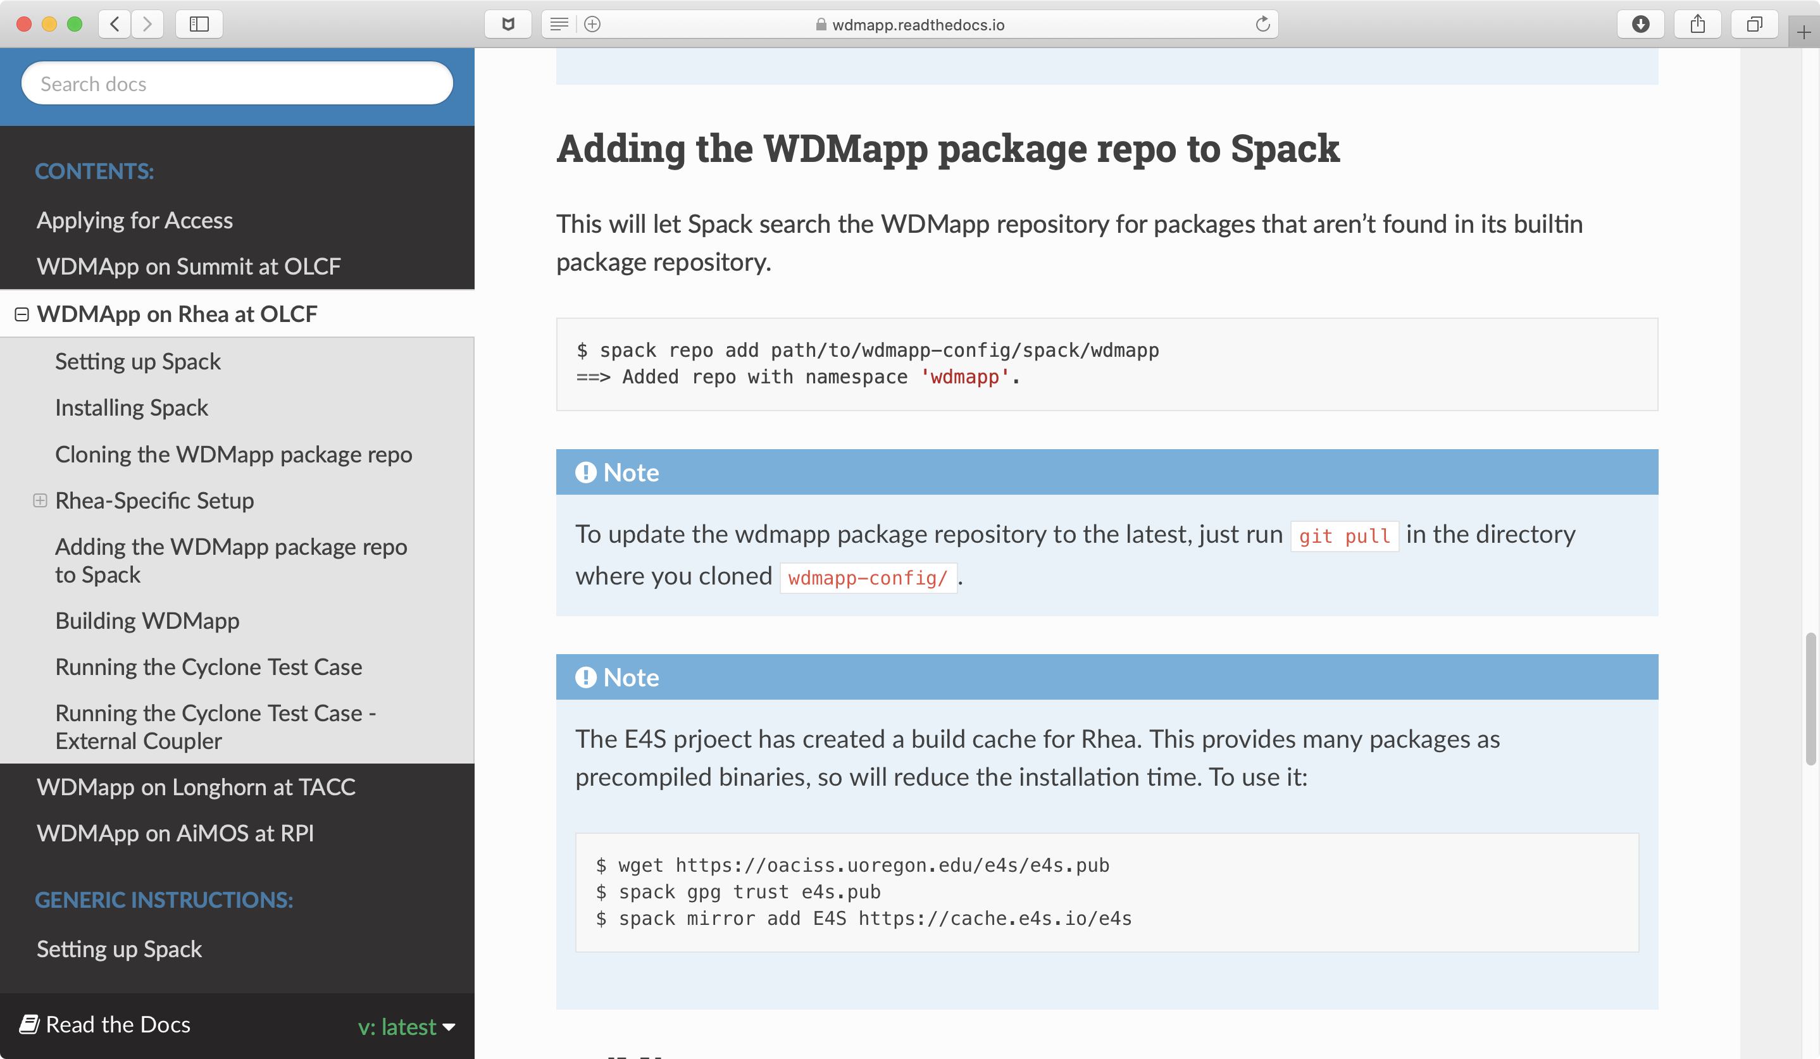
WDMApp: Speeding up bare-metal installs using E4S build cache
E4S Spack build cache
Adding E4S mirror
WDMApp install speeds up!
https://wdmapp.readthedocs.io/en/latest/machines/rhea.html
Notes:
quick run through - what ECP ST is working on

Slide 30
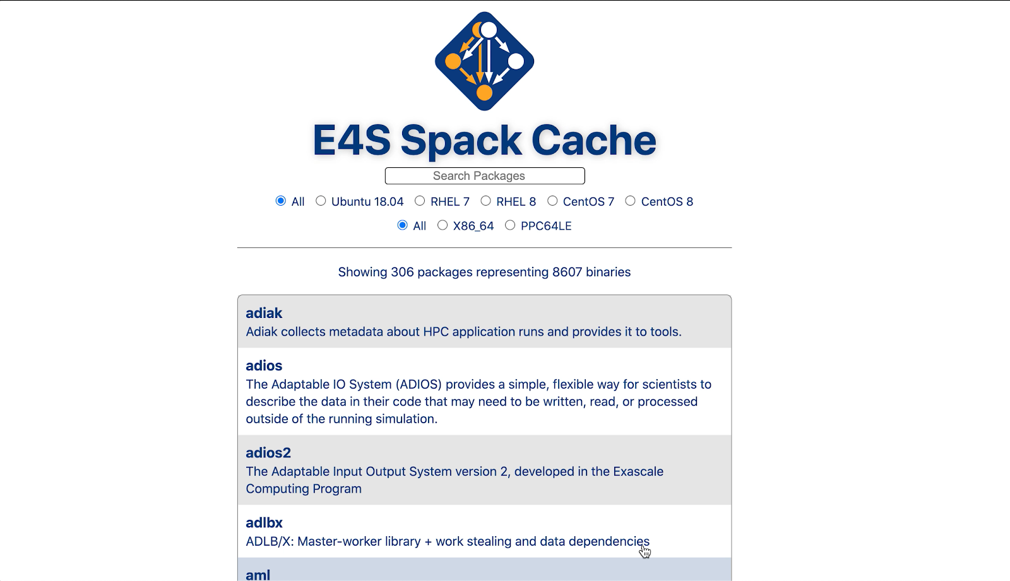
New E4S Spack Cache Website (under development)
Notes:
quick run through - what ECP ST is working on

Slide 31
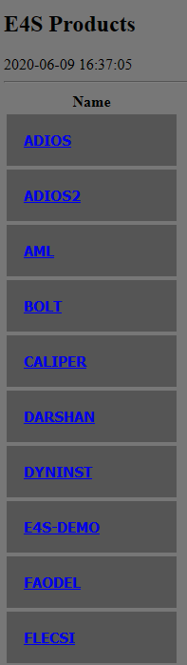
E4S DocPortal
Provide a single online location for accurate product descriptions for ECP software products.
Derived requirements:
Sustainable: Must be integrated into software team workflows.
Incremental: Must build on community approaches to providing this kind of information.
Extensible: Must be usable by any open source software team.
Strategy:
Use the open source community approach of specially-name files in software repositories.
Adopt commonly used file names when available.
Identify new information items not already being requested.
Develop new special file names for information beyond what is already captured.
Create web-based raking tool to capture information from product repositories and present in summary form on a webpage.
Aggregates and summarizes documentation and metadata for E4S products
Regularly updates information directly from product repositories
Prototype: https://e4s-project.github.io/DocPortal.html
Notes:
quick run through - what ECP ST is working on

Slide 32
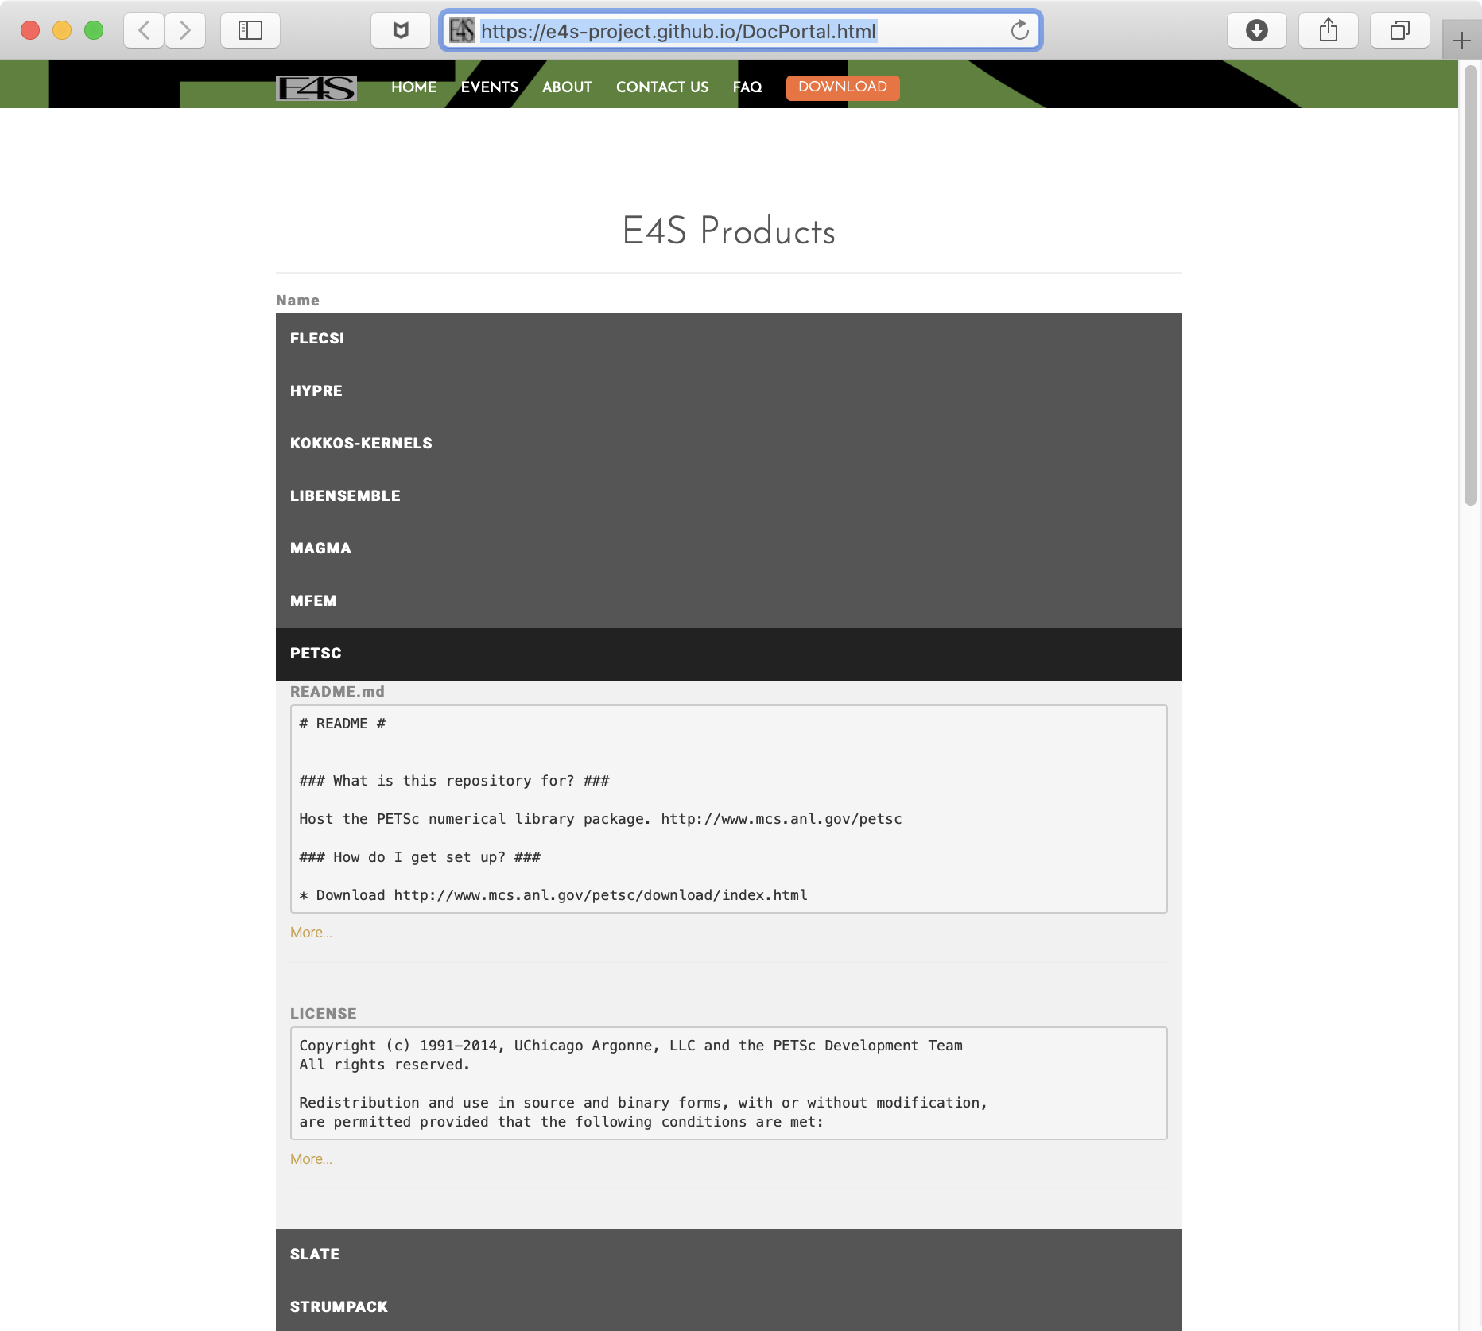
E4S DocPortal
https://e4s-project.github.io/DocPortal.html
Notes:
quick run through - what ECP ST is working on

Slide 33
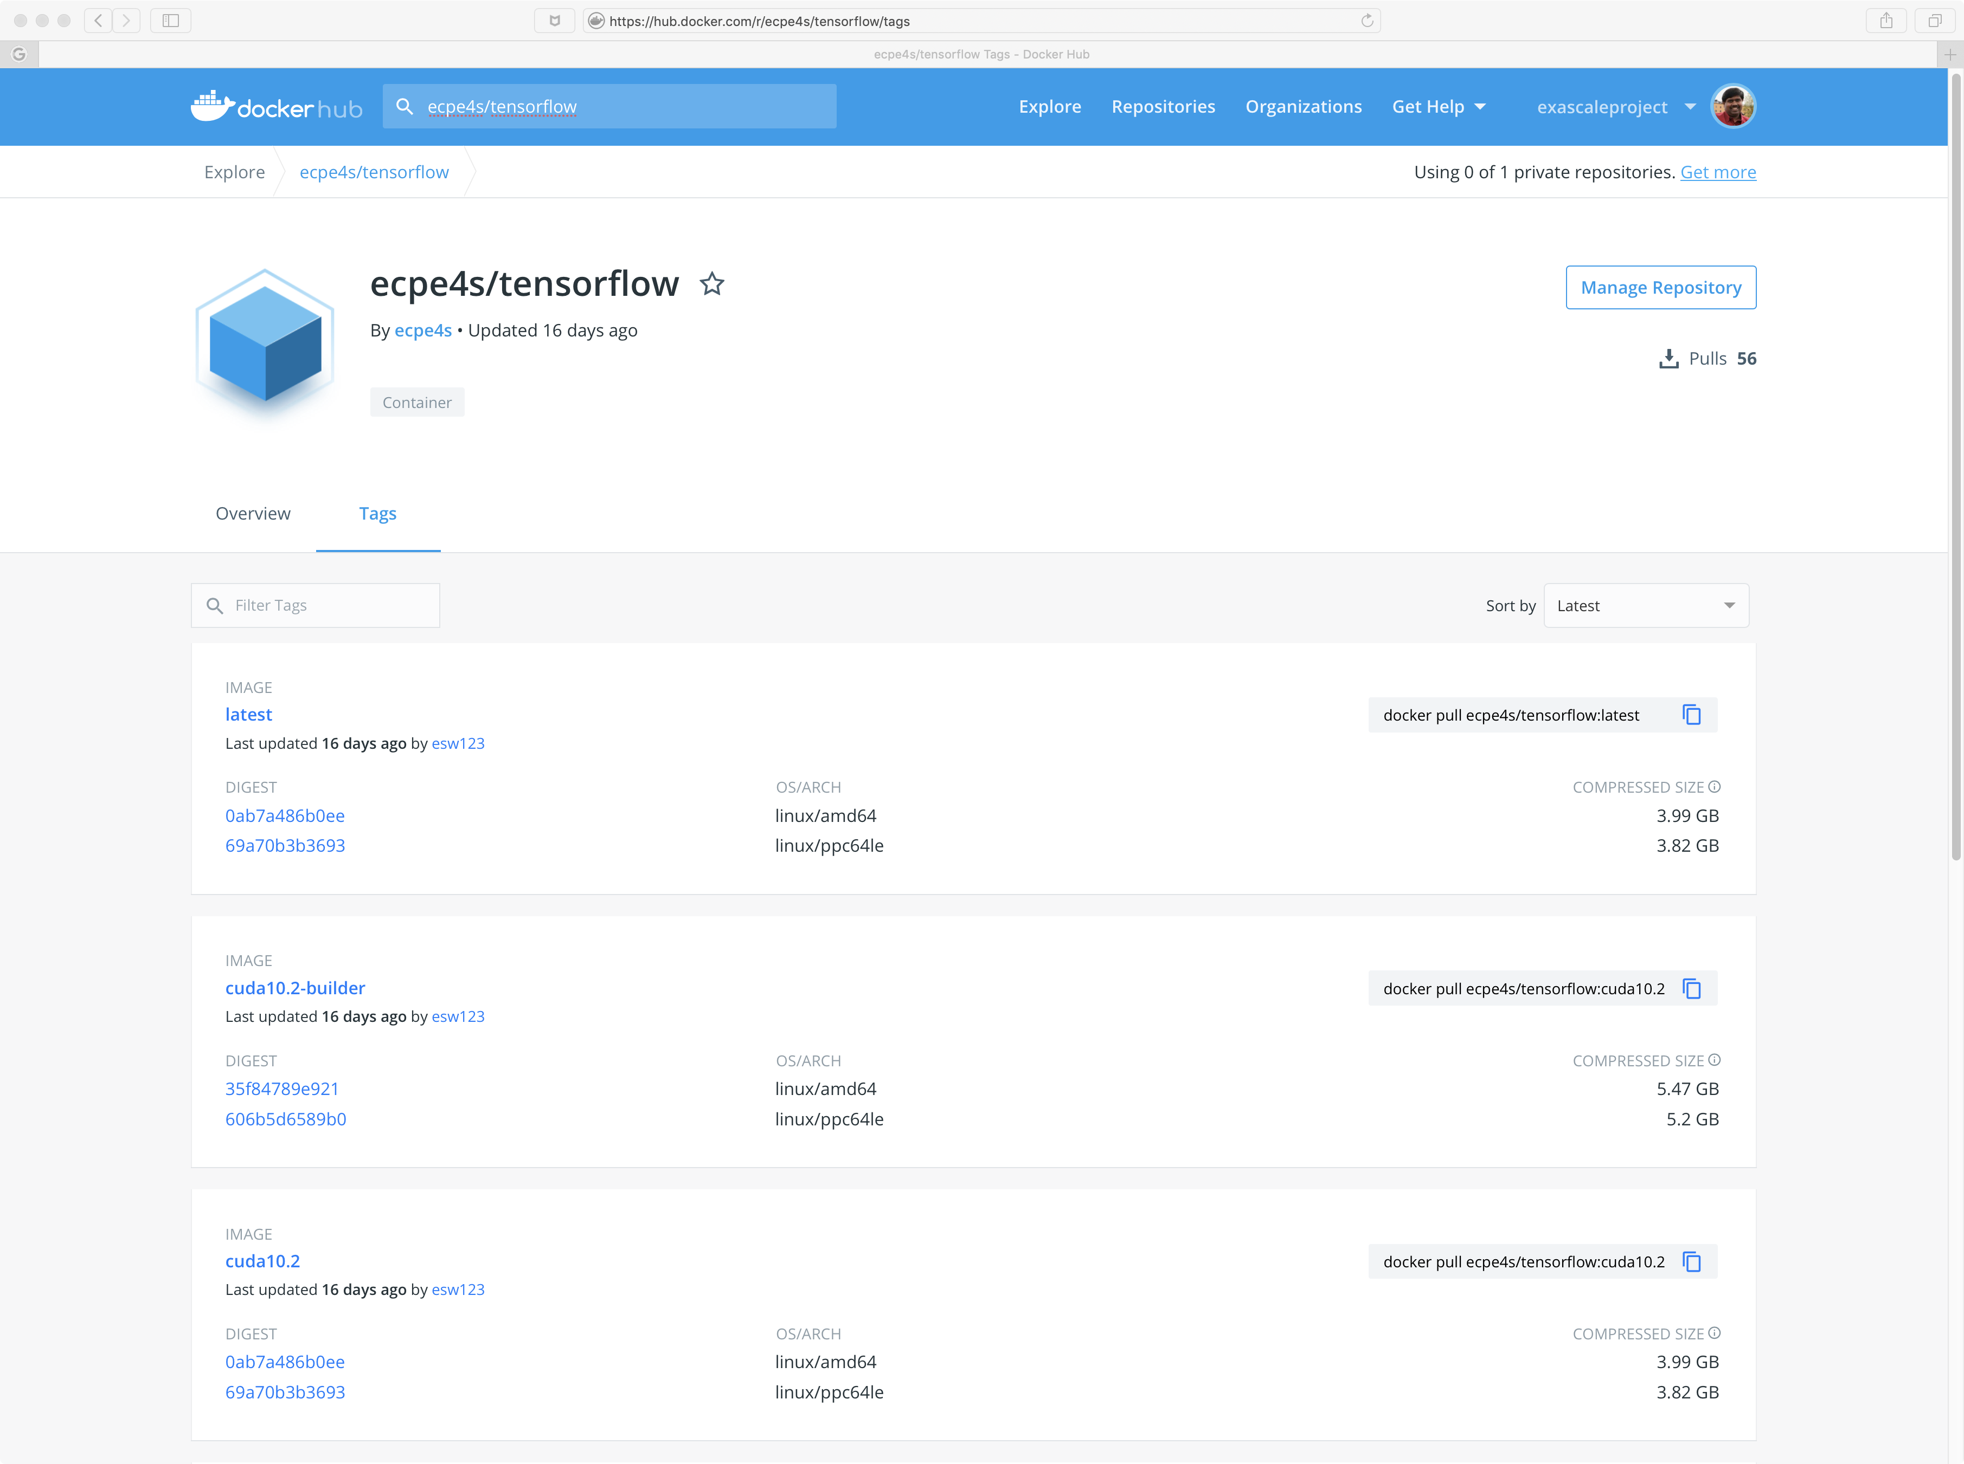
E4S: DockerHub Images: ecpe4s
Dockerhub
Tensorflow 2.2
CUDA 10.2
ppc64le
Notes:
quick run through - what ECP ST is working on

Slide 34
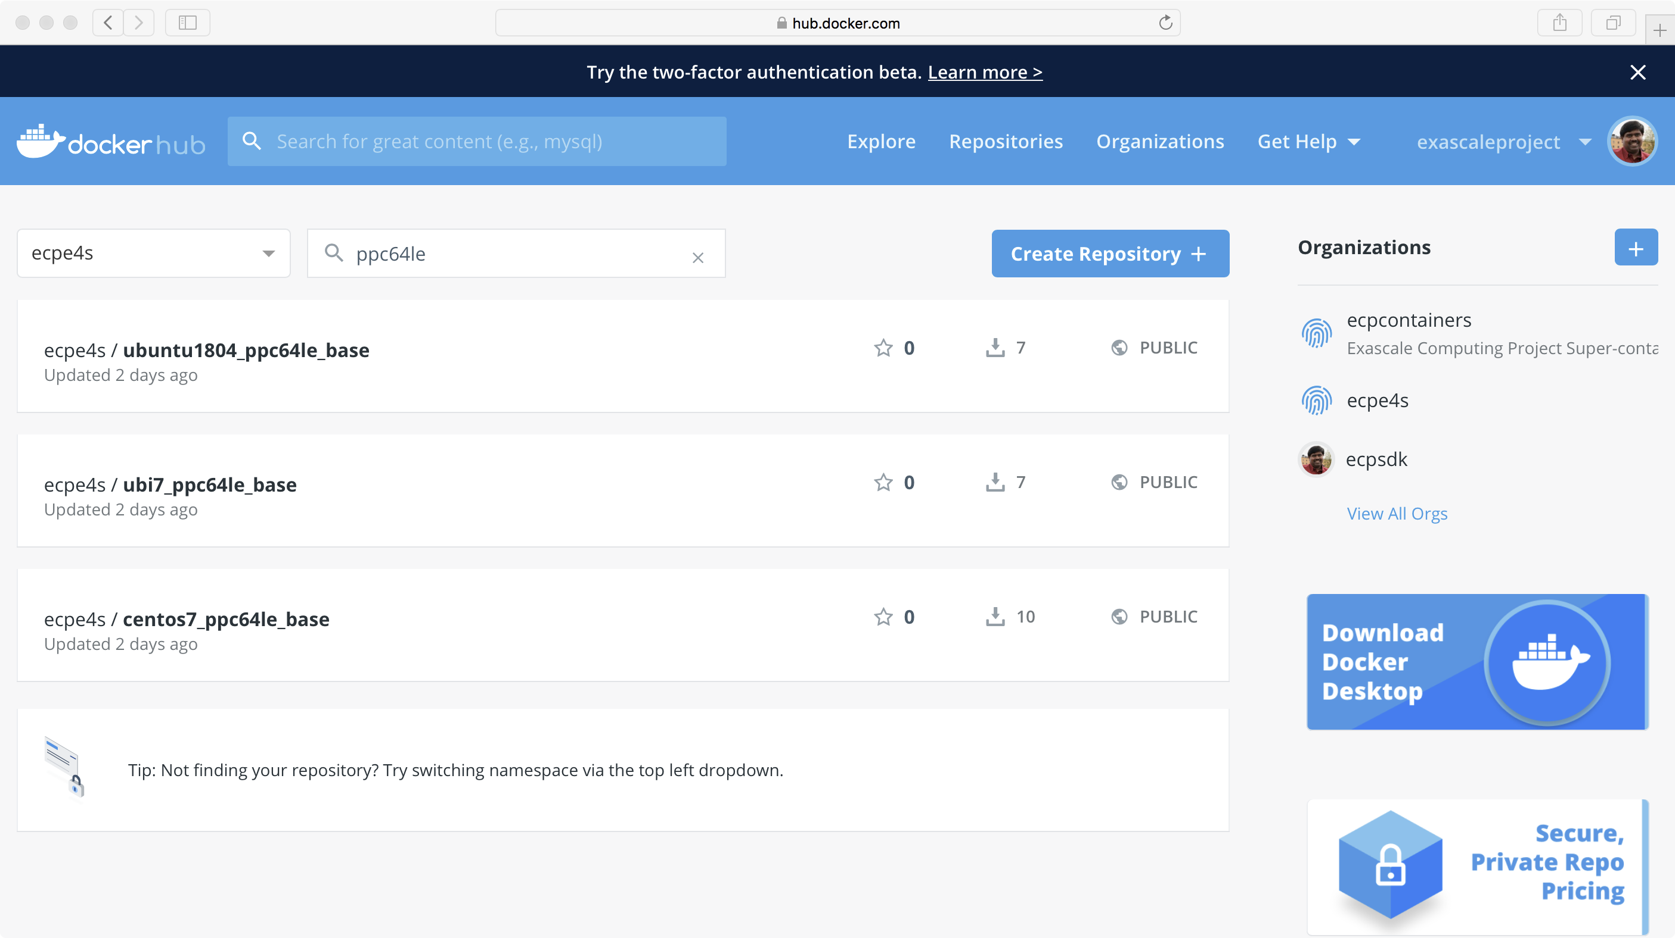
E4S: ppc64le Base Container Images
Hub.docker.com
ecpe4s
Ubuntu 18.04
RHEL/UBI 7.6
Centos 7.6

Slide 35
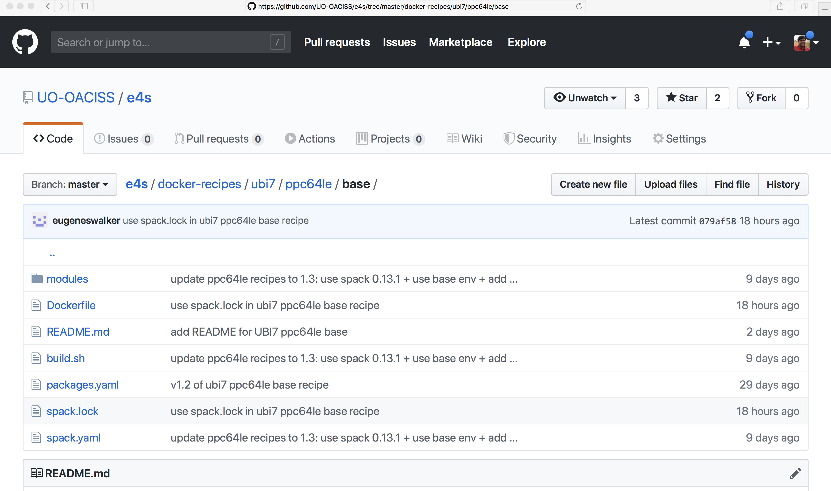
E4S: Multi-platform Reproducible Docker Recipes
E4S base images
x86_64
ppc64le
aarch64
https://e4s.io
Notes:
quick run through - what ECP ST is working on

Slide 36
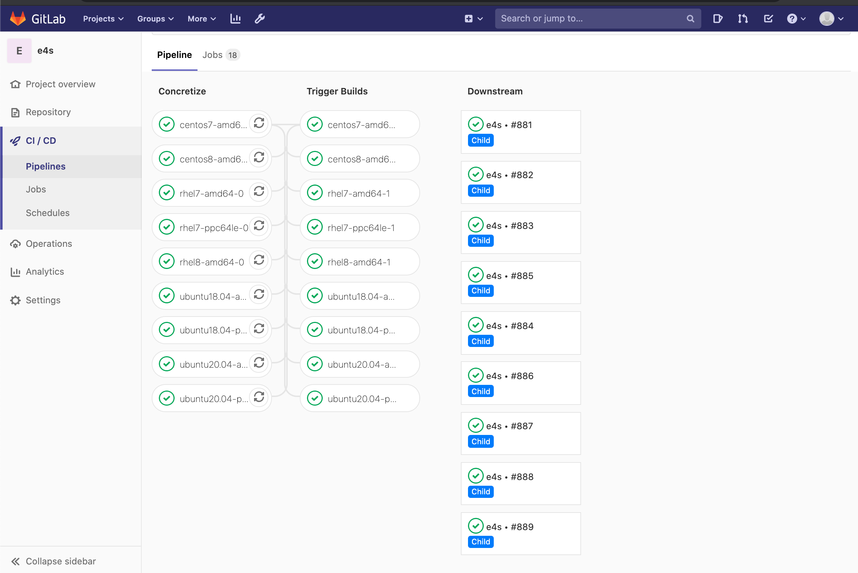
University of Oregon GitLab CI
June 10, 2020
E4S Builds:
Ubuntu 18.04
Ubuntu 20.04
RHEL 7.6
RHEL 8
CentOS 7
CentOS 8
Architectures: ppc64le and x86_64
Notes:
quick run through - what ECP ST is working on

Slide 37
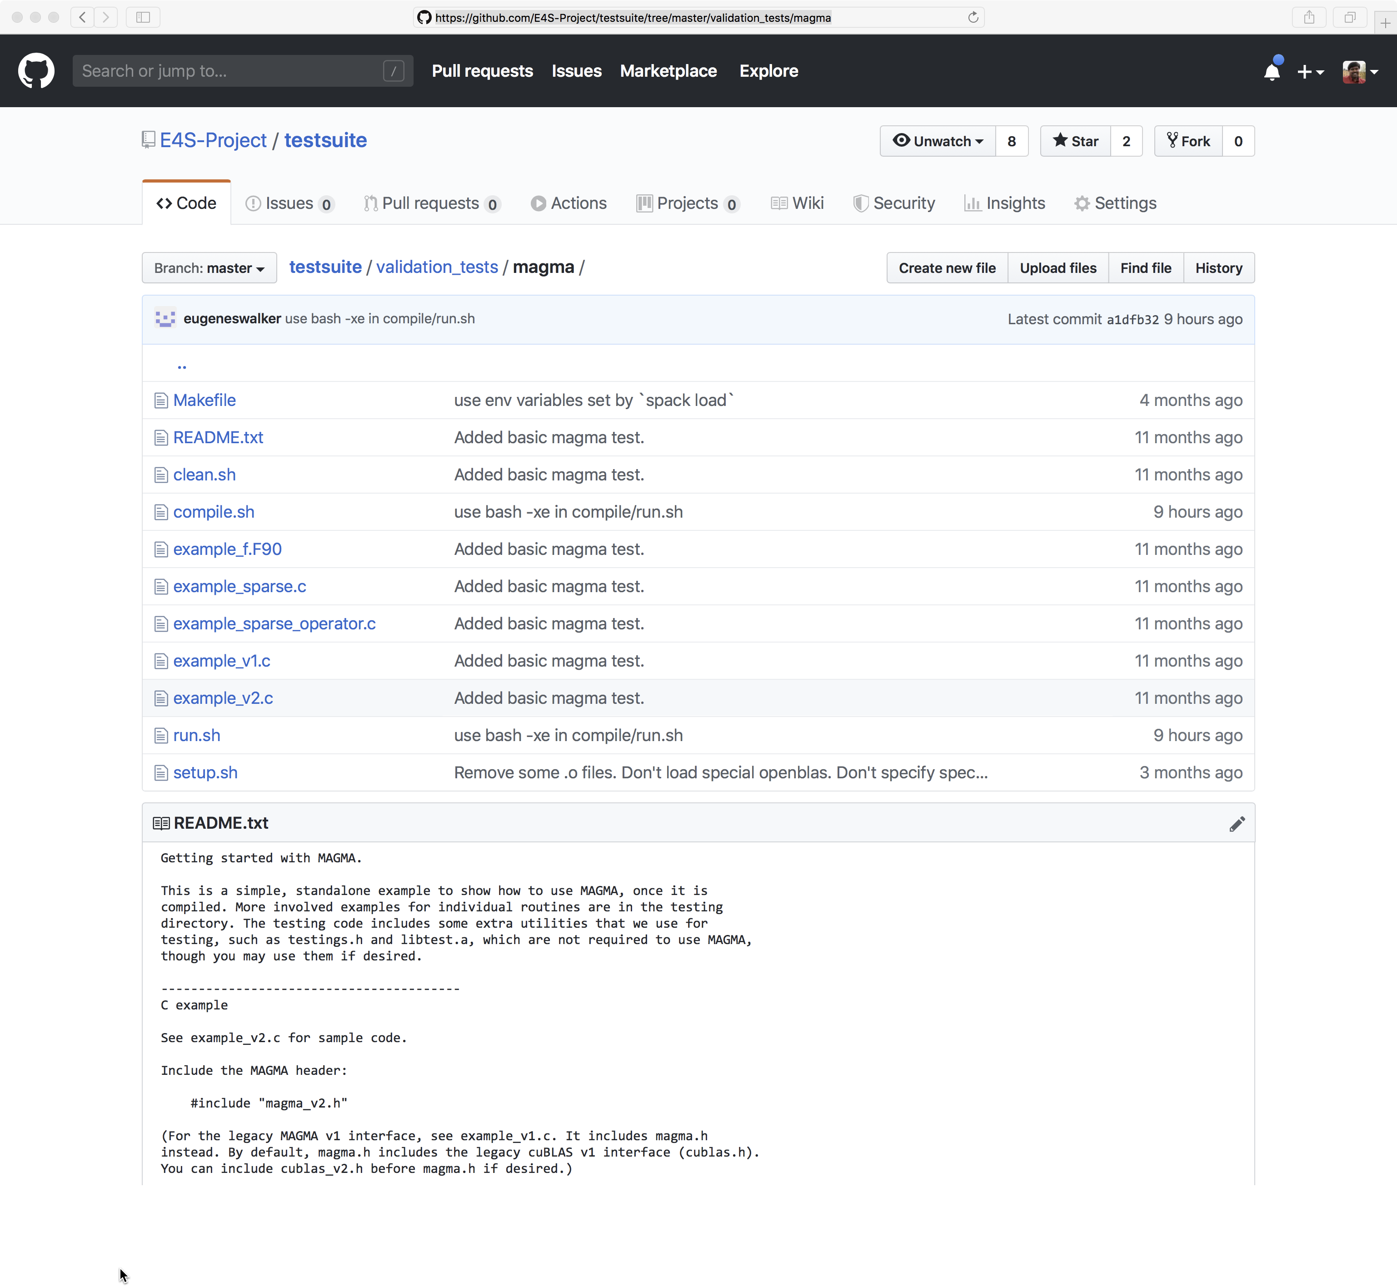
E4S Validation Test Suite
Provides automated build and run tests
Validate container environments and products
New LLVM validation test suite for DOE LLVM
git clone https://github.com/E4S-Project/testsuite.git
Notes:
quick run through - what ECP ST is working on

Slide 38
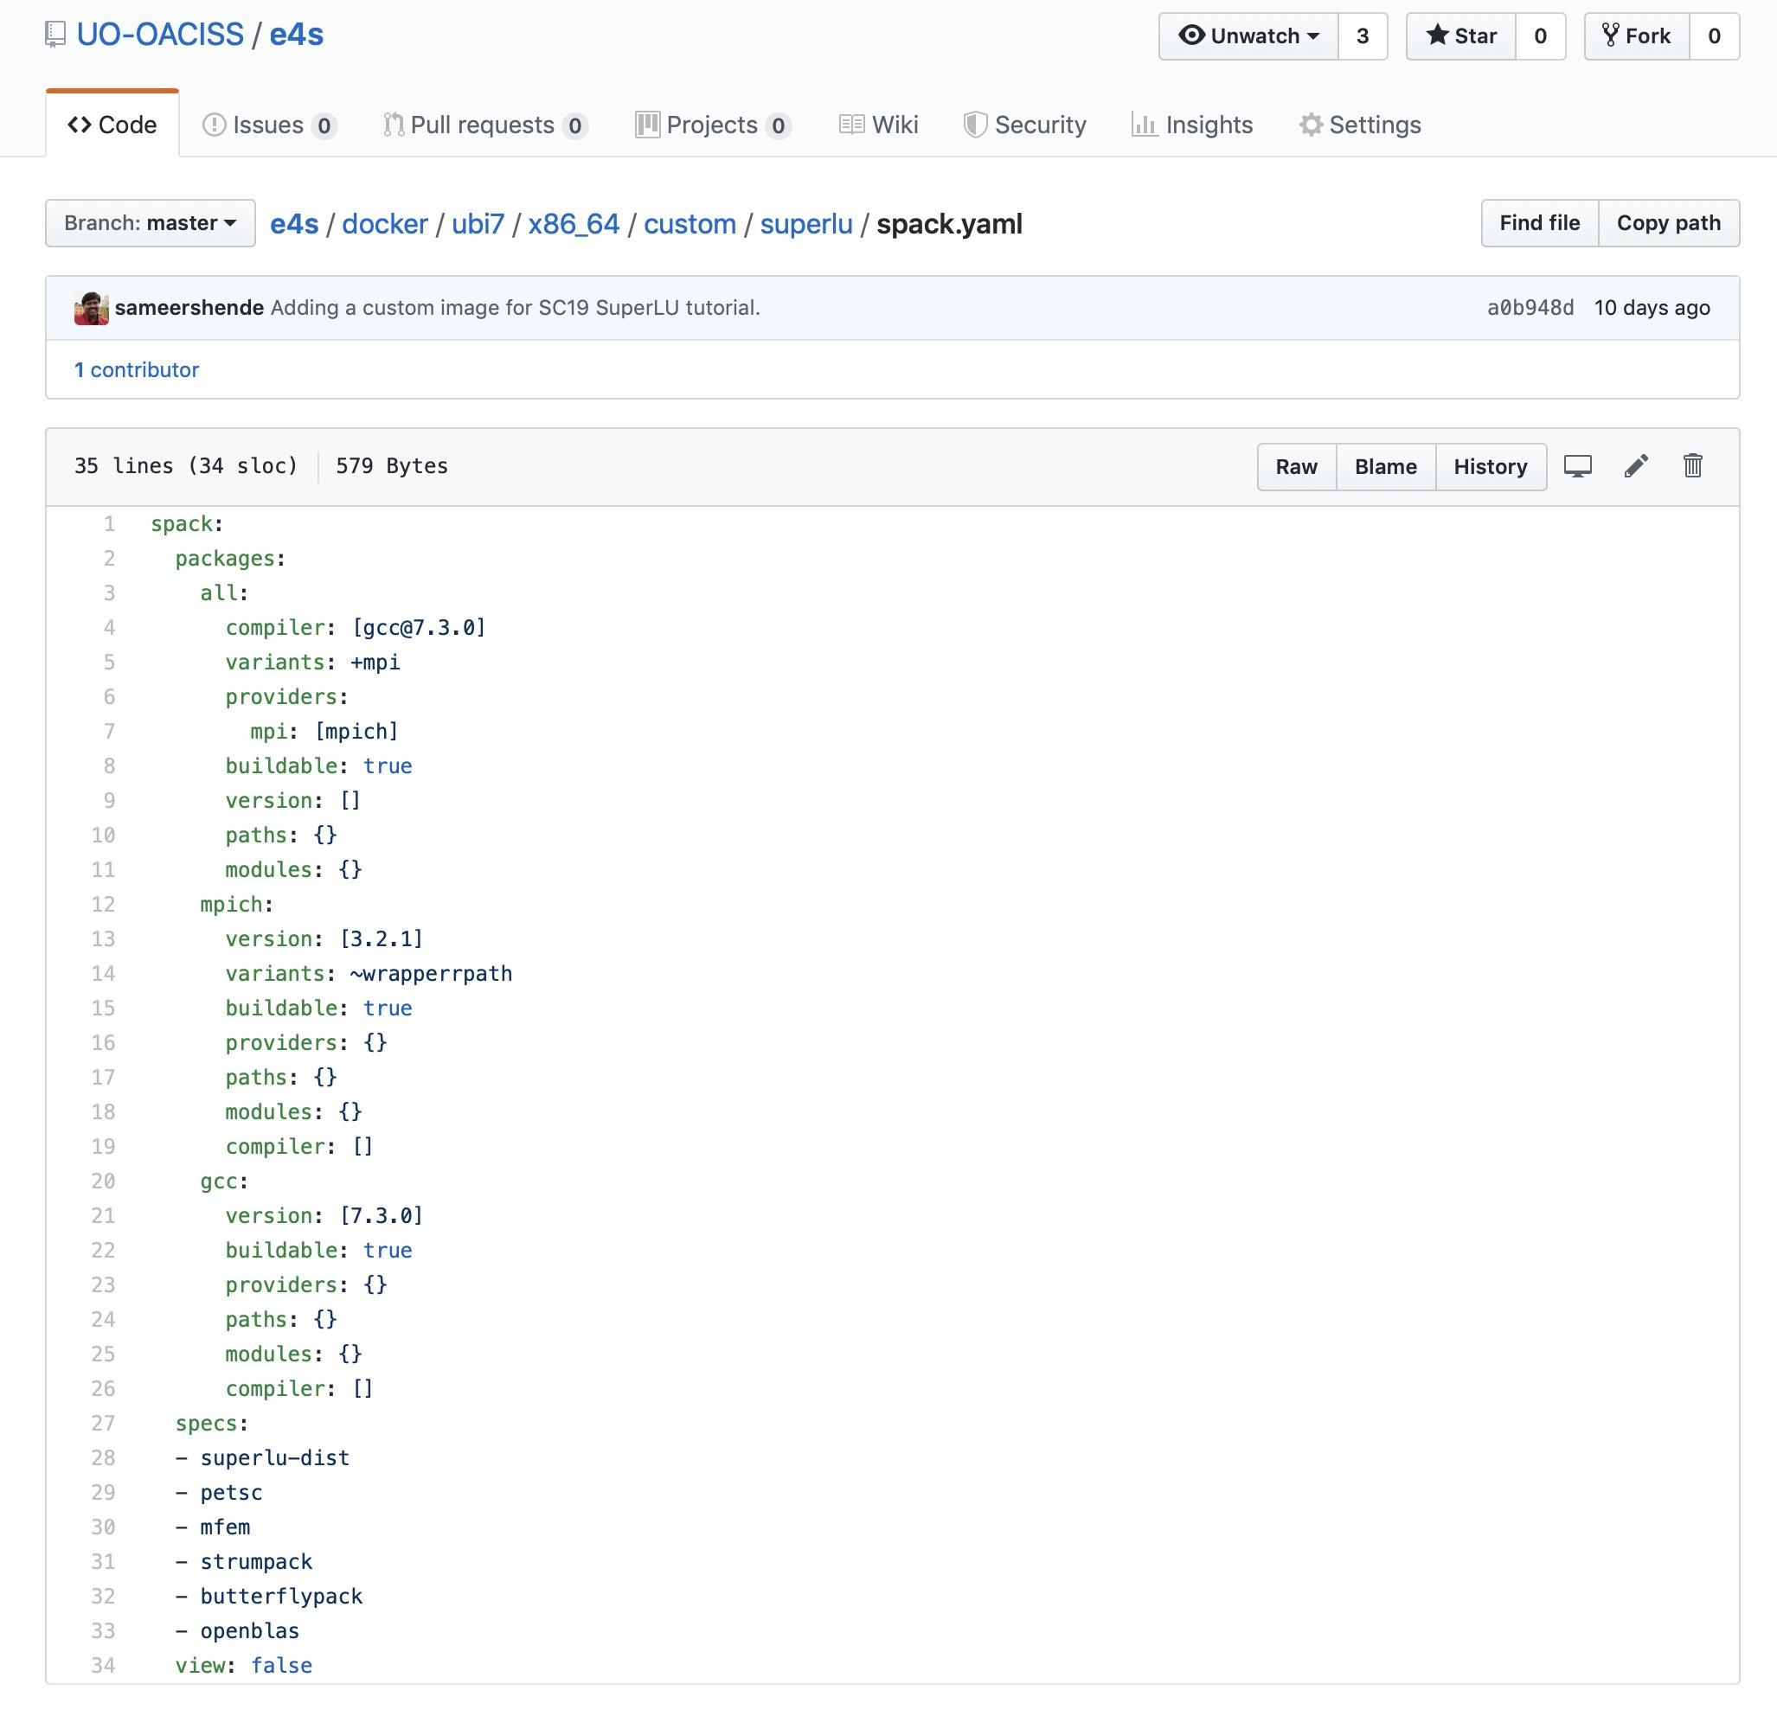
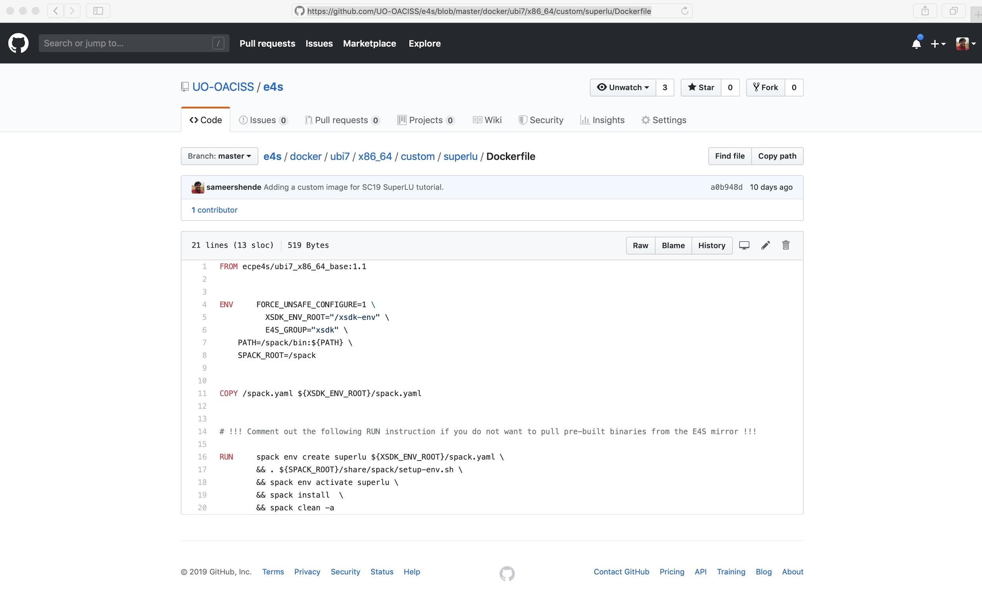
Reproducible Container Builds using E4S Base Images
PMR SDK base image has Spack build cache mirror and GPG key installed.
Base image has GCC and MPICH configured for MPICH ABI level replacement (with system MPI).
Customized container build using binaries from E4S Spack build cache for fast deployment.
No need to rebuild packages from the source code.
Same recipe for container and native bare-metal builds with Spack!

Slide 39
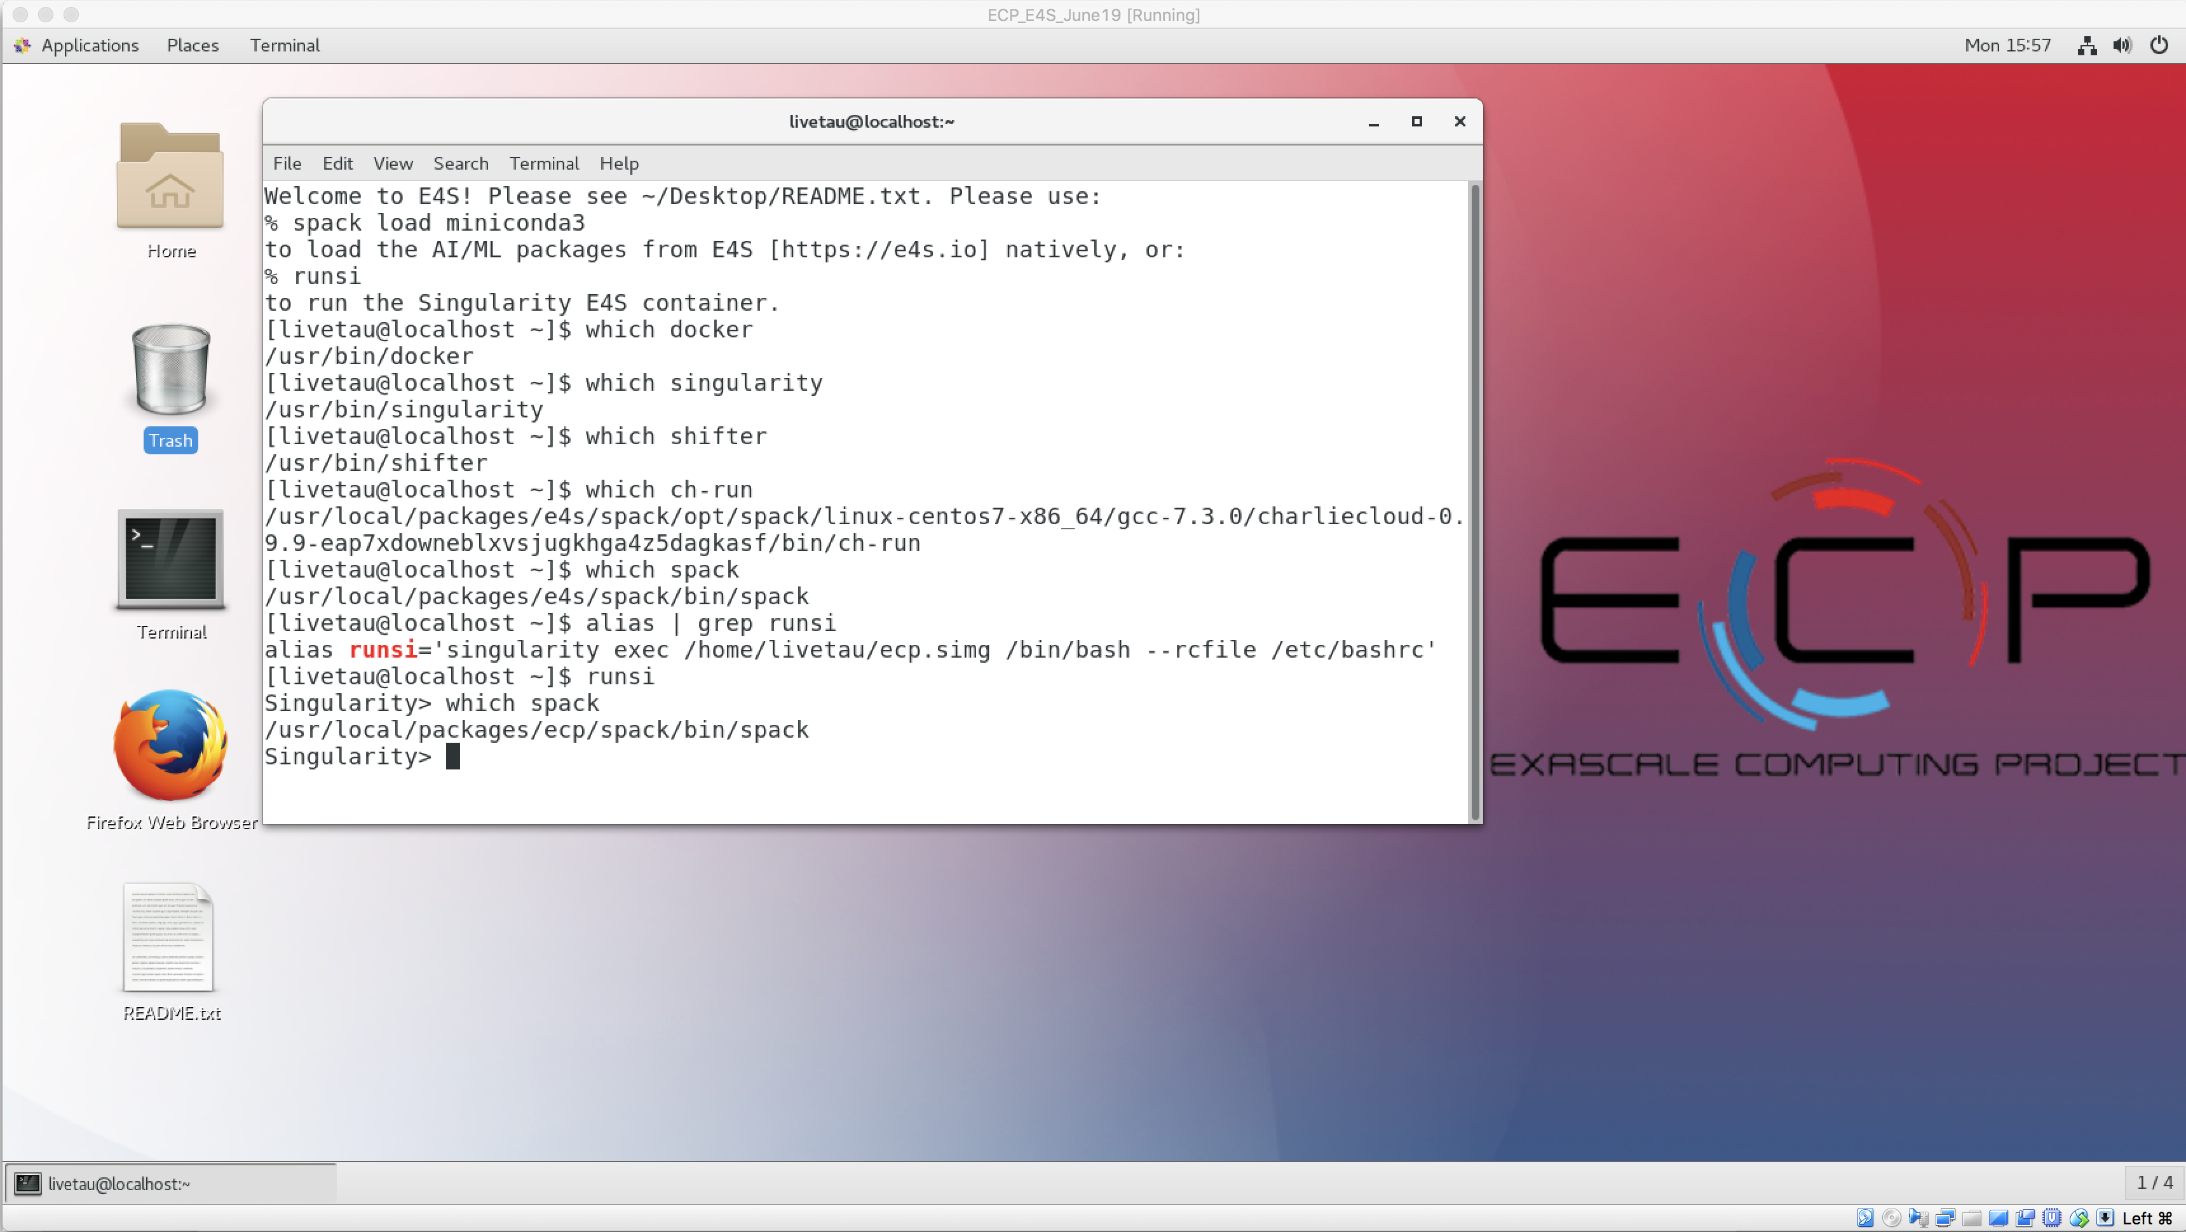
E4S VirtualBox Image
Container Runtimes
Docker
Shifter
Singularity
Charliecloud
https://e4s.io
Notes:
quick run through - what ECP ST is working on

Slide 40
e4s-cl: A tool to simplify the launch of MPI jobs in E4S containers
E4S containers support replacement of MPI libraries using MPICH ABI compatibility layer.
Applications binaries built using E4S can be launched with Singularity using MPI level replacement for efficient inter-node communications.
e4s-cl is a new tool that simplifies the launch and MPI replacement.
Usage:
e4s profile create <name> --backend <singularity|docker…> --image <path/to/image> --add-libraries <lib1> ... [--add-files <f1> ... ]
e4s launch --profile <name> mpirun -np <> -hosts <> <command>
e4s launch --backend <singularity|docker|etc> --image <path/to/image> --libraries <lib1> ... [--files <f1> ... ] mpirun -np <> -hosts <> <command>
https://e4s.io
Notes:
quick run through - what ECP ST is working on

Slide 41
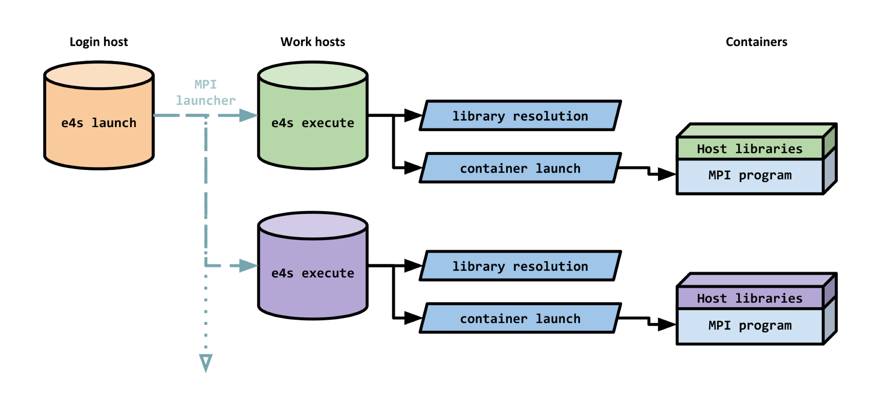
e4s-cl Container Launcher
https://e4s.io
Notes:
quick run through - what ECP ST is working on

Slide 42
E4S: Building on top of previous efforts
E4S did not emerge from nothing.
Leveraging the work of many others.
HPC Linux: Work done at U. of Oregon, and at ParaTools, Inc.
IDEAS-Classic: xSDK – the original SDK continuing under ECP.
Spack – Pre-dates E4S.

Slide 43
E4S Summary
What E4S is not
What E4S is
A closed system taking contributions only from DOE software development teams.
A monolithic, take-it-or-leave-it software behemoth.
A commercial product.
A simple packaging of existing software.
Extensible, open architecture software ecosystem accepting contributions from US and international teams.
Framework for collaborative open-source product integration.
A full collection if compatible software capabilities and
A manifest of a la carte selectable software capabilities.
Vehicle for delivering high-quality reusable software products in collaboration with others.
The conduit for future leading edge HPC software targeting scalable next-generation computing platforms.
A hierarchical software framework to enhance (via SDKs) software interoperability and quality expectations.

Slide 44

Acknowledgment
“This research was supported by the Exascale Computing Project (17-SC-20-SC), a collaborative effort of two U.S. Department of Energy organizations (Office of Science and the National Nuclear Security Administration) responsible for the planning and preparation of a capable exascale ecosystem, including software, applications, hardware, advanced system engineering, and early testbed platforms, in support of the nation’s exascale computing imperative.”

Slide 45


